Slide 1

What is VRF and Strategies to promote Hydronics?

Slide 2
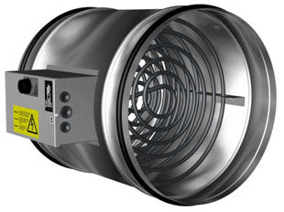
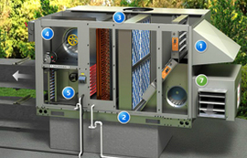
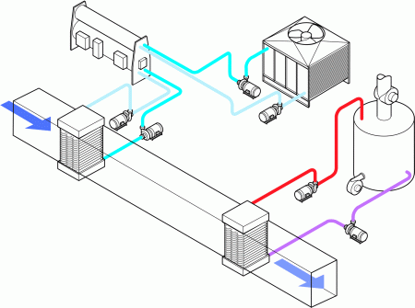
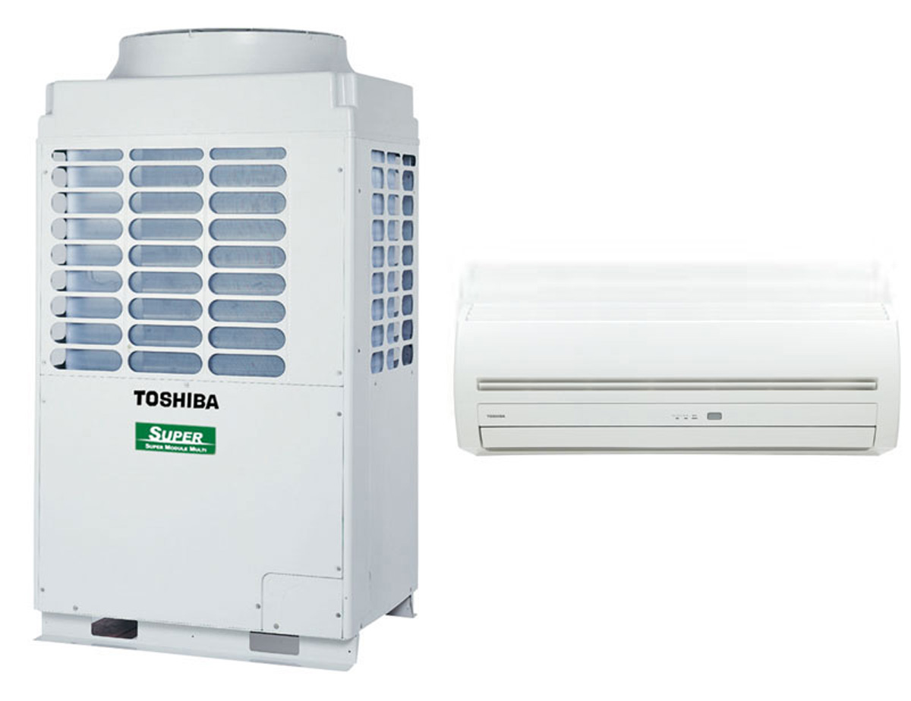
VRF Comparisons
VRF Comparisons
VRF IS ONLY ANOTHER OPTION!!! Not the Answer to Everything!
DOAS System
Hydronic Air Handler

Slide 3

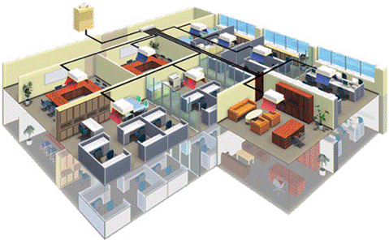
What is VRF?
Definition of VRF systems: ASHRAE 90.1-2013 Standard
Variable-Refrigerant-Flow (VRF) system: an engineered direct expansion (DX) multisplit system incorporating at least one variable capacity compressor distributing refrigerant through a piping network to multiple indoor fan-coil units, each capable of individual zone temperature control, through integral zone temperature control devices and common communications network. Variable refrigerant flow utilizes three or more steps of control on common, interconnecting piping.

Slide 4





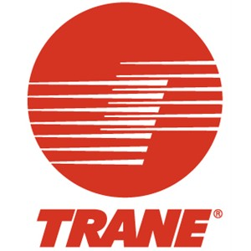






VRF Current Manufactures
A Typical VRF System is between 3-30 tons per unit.

Slide 5

VRF Building Sizes........
Building Size VRF system
What was suggested to the GSA by a Pacific Northwest National Laboratory?
Under 5,000 ft² to 10,000 ft² may be less suitable because there are substantially less expensive alternatives than VRF. Above 80,000 ft² to 120,000 ft², other alternatives, such as VAV chilled water and hot water reheat systems with high efficiency plant equipment, and controls consistent with ASHRAE Standard 90.1-2010, may be more cost-effective.
Sweet Spot for VRF is 15,000ft²- 60,000ft²
Does not mean VRF could not be installed in the 80,000ft² and up!!!
In Japan, VRF systems are used in approximately 50% of medium-sized commercial buildings (up to 70,000 ft² [6500 m²]) and one-third of large commercial buildings (more than 70,000 ft² [6500 m²]).- ASHRAE Journal April 2007

Slide 6
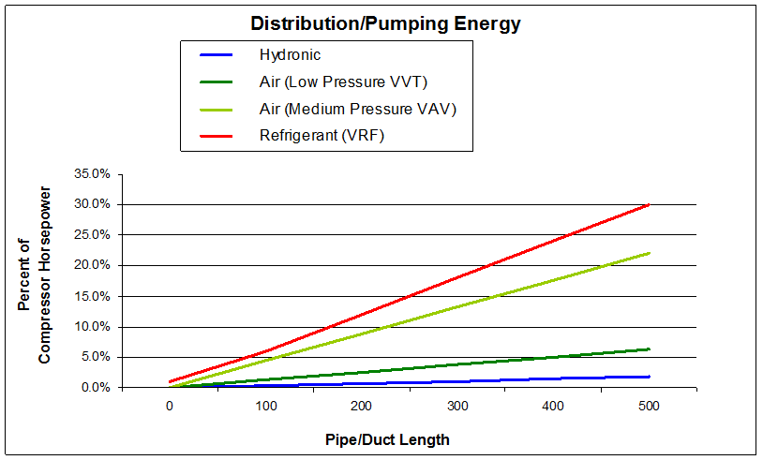
15,000 sqft- 60,000 sqft HVAC System Breakdown

Slide 7
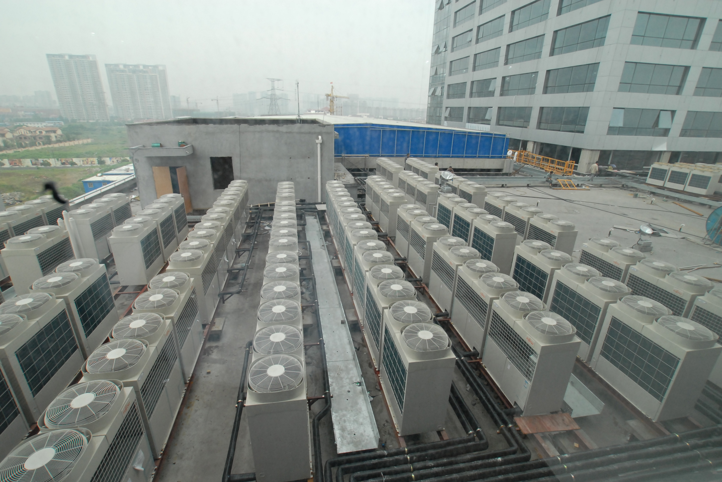
You want How Many Roof Penetrations?

Slide 8
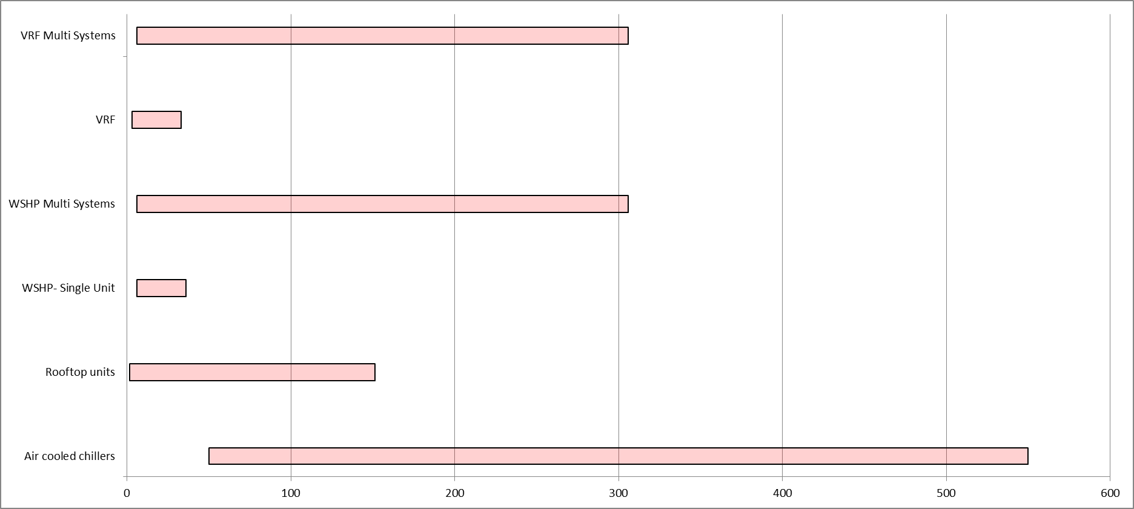
VRF Cross over Tonnage Map

Slide 9
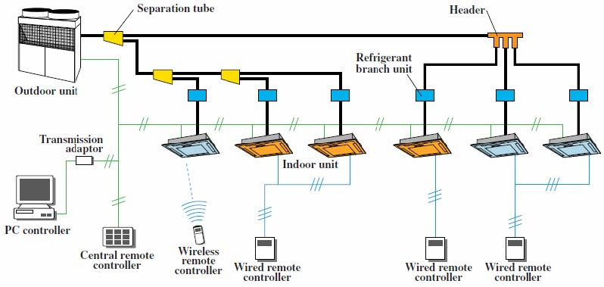
VRF system – How does it work?
Notes:
Ask what is the only nonproprietary item in the system?

Slide 10
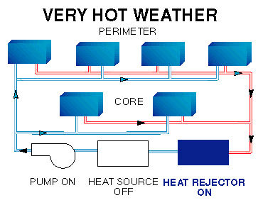
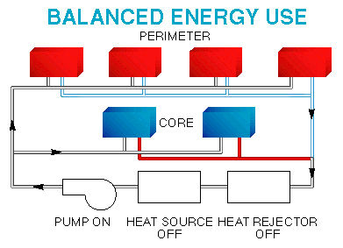
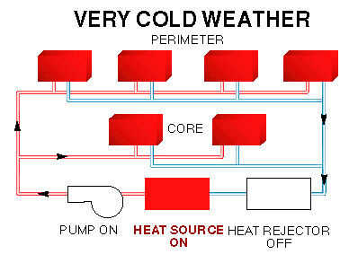
WSHP System with boiler- Hydronic System
Hot Humid Temperatures
Below Zero Operation!
Loop Temperature Range: 50F – 110F

Slide 11
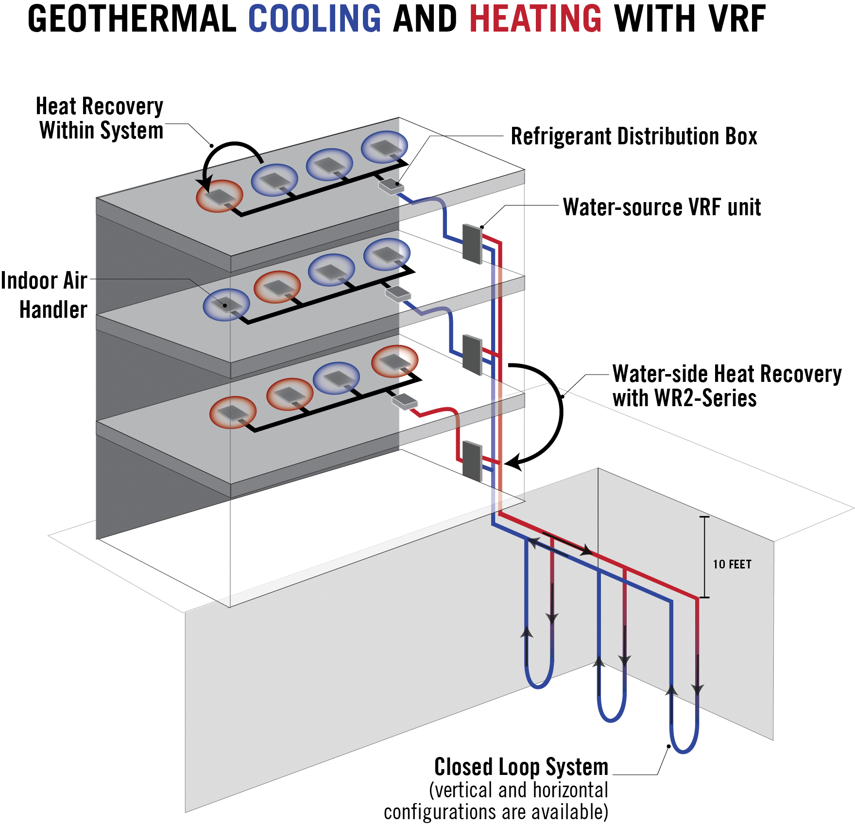
Geothermal VRF system

Slide 12
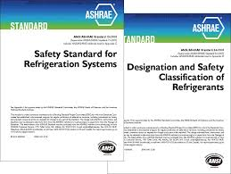
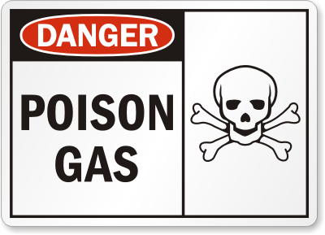
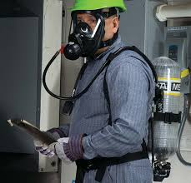
ASHRAE 15 and 34 Standard- VRF
Why is ASHRAE 15 and 34 so important when applying to VRF?
Large Amounts of Refrigerant in Occupied Space
LIFE SAFTEY!!!
May Cause Building Space Redesign!

Slide 13
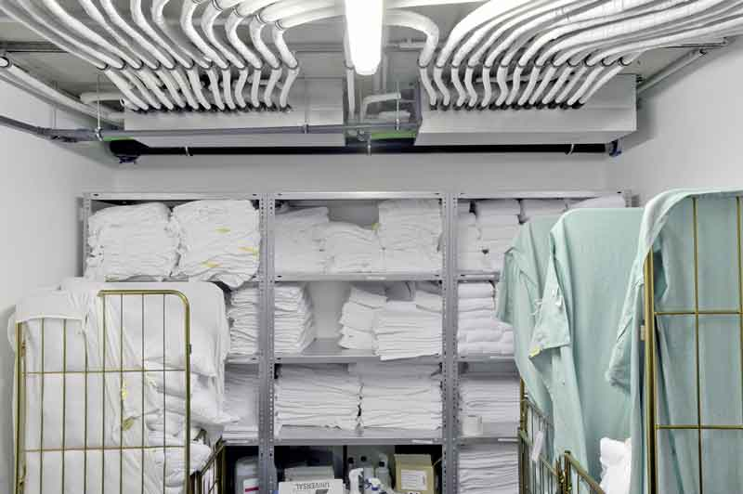
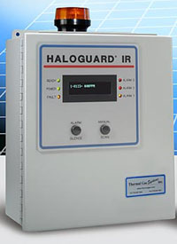
VRF/ V system –ASHRAE 15- Ref Standard
VRF systems must comply with ASHRAE Standard 15-2013 - Safety Standard for Refrigeration Systems (ANSI approved).
Few VRF manufacturers have developed products and protocols to address the concerns of refrigerant leakage.
Operating Pressures of R-410A
High Side: 418 psig
Low side: 130psig

Slide 14
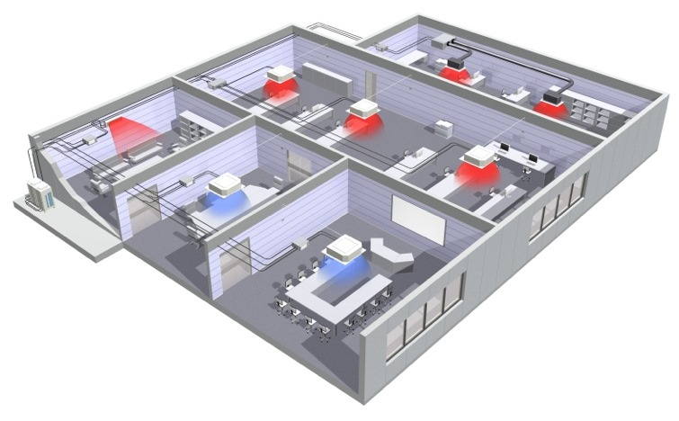
VRF/ V system –ASHRAE 15
Office Example:
What is the smallest size office that can be allowed in building according to ASHRAE 15?
52 Lbs of 410A Refrigerant
Single storey Office building
Operating Pressures of R-410A
High Side: 418 psig
Low side: 130psig

Slide 15
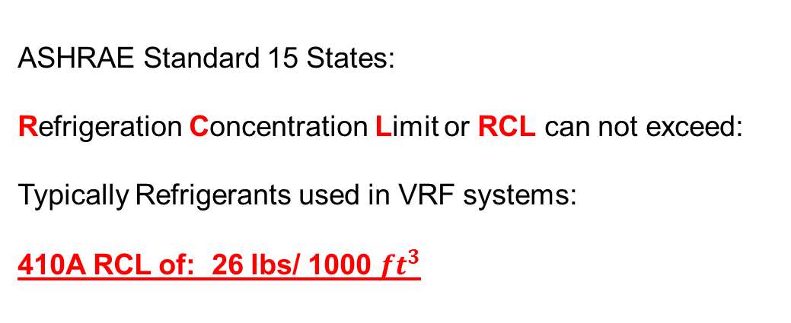
VRF system –ASHRAE 15
Office Example:
52 lbs. of 410a Refrigerant
Single storey Office building
What is the smallest allowable office?
ASHRAE Standard 15 States:
Refrigeration Concentration Limit or RCL can not exceed:
Typically Refrigerants used in VRF systems:
410A RCL of: 26 lbs/ 1000 $ft^{3}$

Slide 16

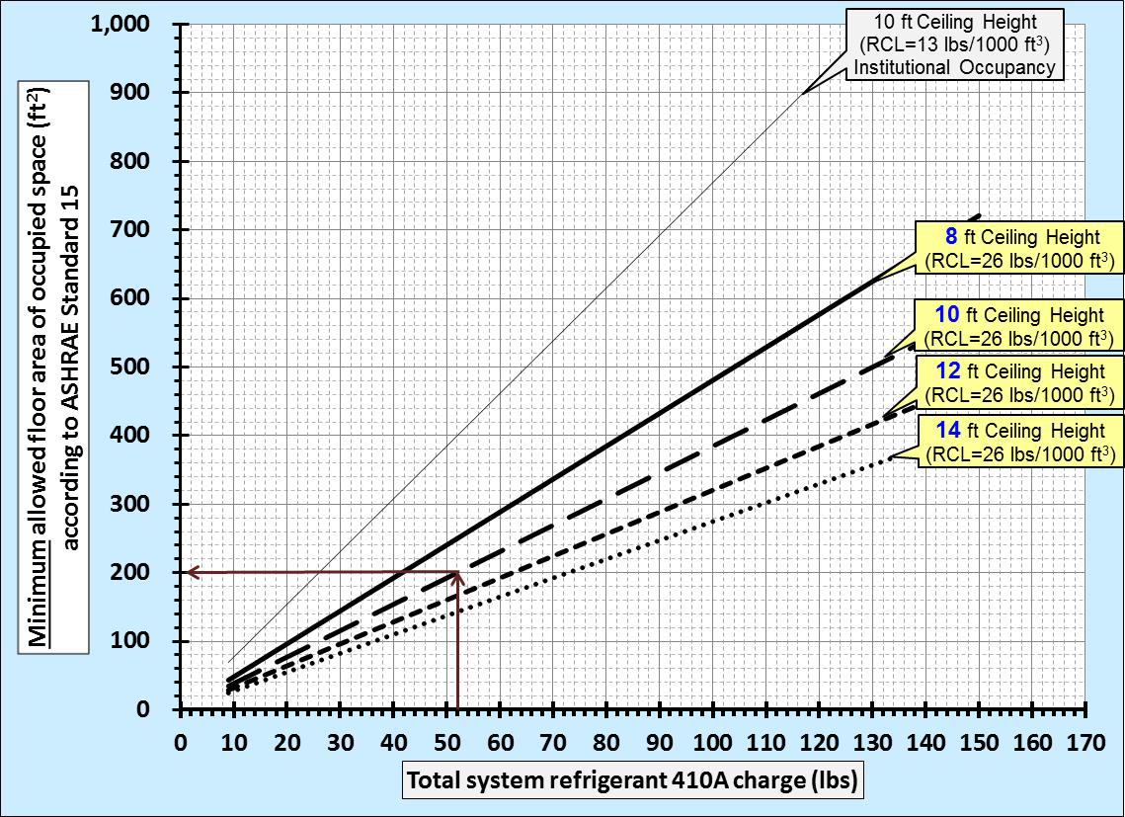
VRF system –ASHRAE 15-2013
Office Example:
Example:
According to Standard 15, minimum allowed floor area is 200 ft2 if the ceiling height is 10 ft. for a noninstitutionalized occupancy space that has part of a 52 lbs R410A charge piping circuit installed.
So a closed Office can not be smaller than
10 ft. X 20ft in this design.

Slide 17
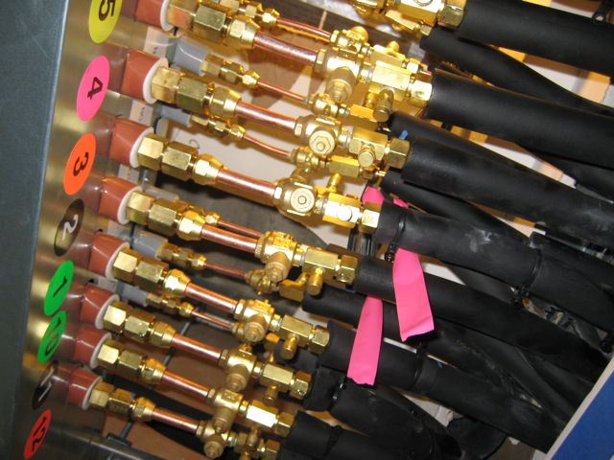
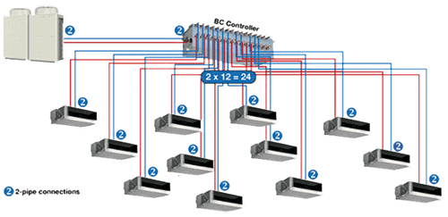
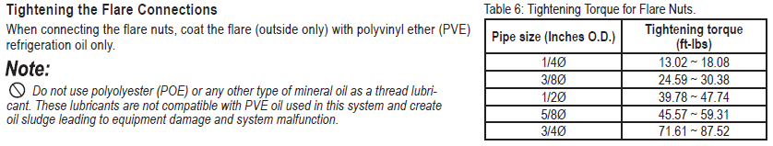
VRF system –ASHRAE 15
How would you like to Leak Check these connections?
Testing Pressure in VRF System: 551 PSI!!!
Hydronics (Pressures of 30-40 PSI Typically)

Slide 18

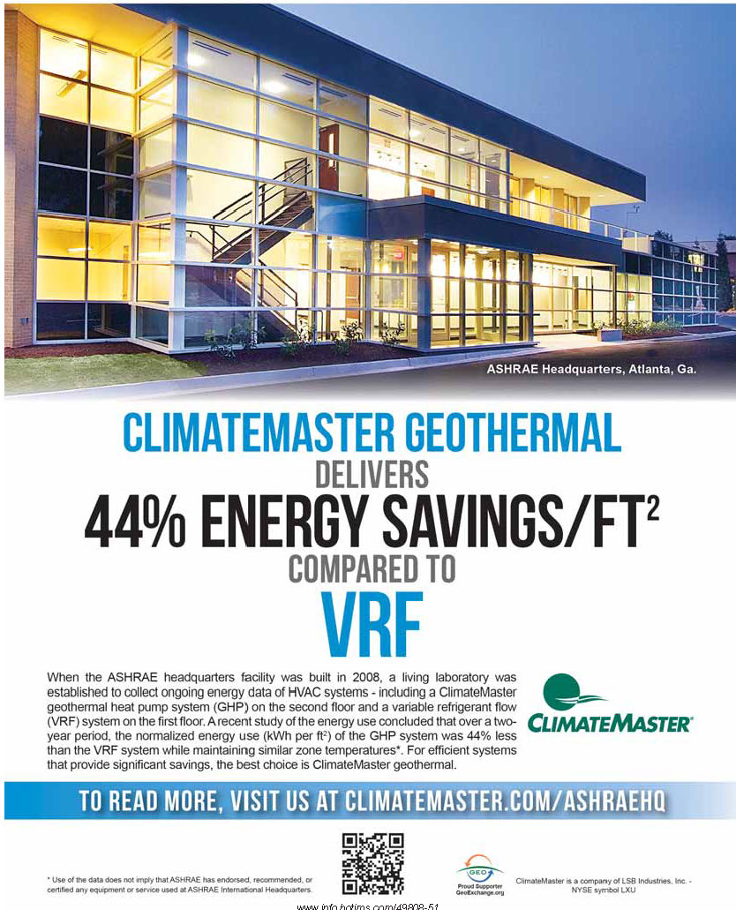
ASHRAE- Atlanta Case Study
Courtesy of the ASHRAE Journal – September 2014 edition

Slide 19
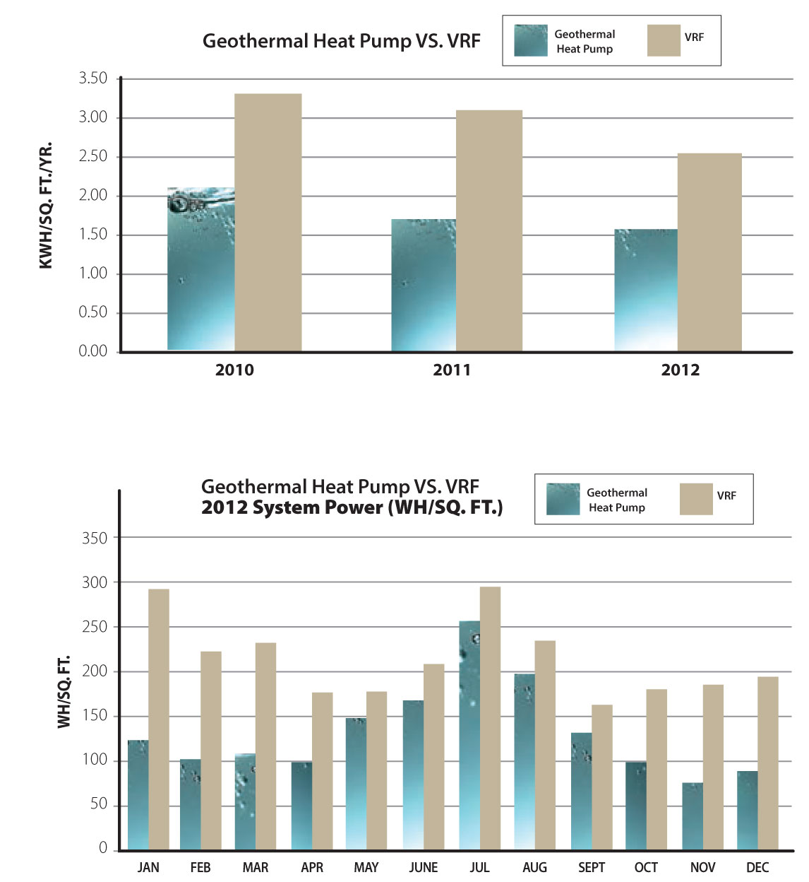
ASHRAE- Atlanta Case Study
ASHRAE’s Conclusion
The ASHRAE headquarters living lab is a valuable
resource of information regarding the real performance
of high efficiency HVAC systems in an operational office
building environment. The efforts described in this
article have barely touched the surface of the vast opportunities
that are available to researchers through this
resource.
During the two-year period that this study encompassed
the GSHP system used about 20% and 60% less
energy than the VRF system in the summer and winter/
shoulder seasons, respectively, while maintaining similar
zone temperatures. Factors contributing to the differences
in energy use include:
Ground loop water supply temperatures were more
favorable than ambient air temperatures for heat pump
operation. This allows the GSHP equipment to operate at
higher efficiencies.
The control strategy of the VRF system resulted in longer
runtimes than the GSHP system, especially in mild
weather. These longer runtimes coincided with significant
amounts of simultaneous cooling and heating in
adjacent spaces.

Slide 20
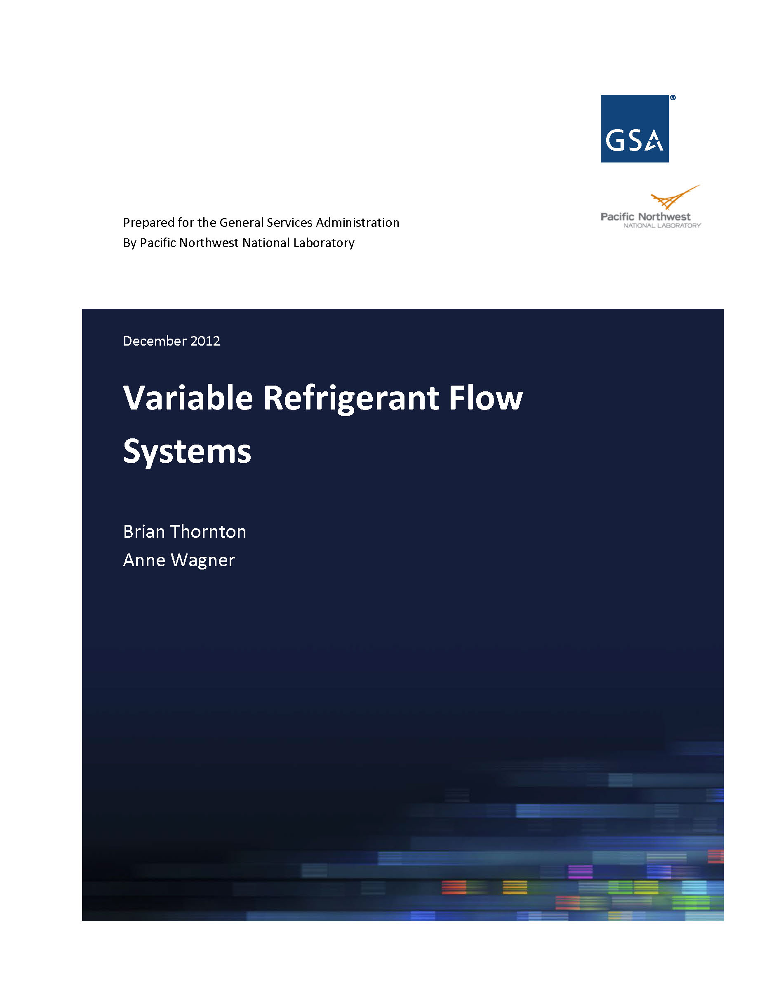
What has been Recommended to GSA…

Slide 21
What have been Recommended to GSA…
VRF systems are most cost-effective when matched with applications and climates that offer the best value given the typically higher initial cost of the systems. (Page 53)
VRF systems are often designed with active involvement and even complete design from manufacturers with proprietary content and specific products selected. This will be difficult for GSA to reconcile with its approach to procurement, which begins with an independent design, followed by contractor bidding, with the selected bidder building the building, known as design/bid/build.
Projects under 5,000 ft² to 10,000 ft² may be less suitable because there are substantially less expensive alternatives than VRF. Above 80,000 ft² to 120,000 ft², other alternatives, such as VAV chilled water and hot water reheat systems with high efficiency plant equipment, and controls consistent with ASHRAE Standard 90.1-2010, may be more cost-effective. Chilled beam systems also with high-efficiency plant equipment, water-side economizer (in less humid climates) and energy recovery are another possibility worth considering.
Weaker Candidates : Large open spaces, such as big box retail, assembly halls, gymnasiums, and warehouses, can be served much less expensively with single-zone systems. Mild climates with a large number of economizer operating hours (ASHRAE climate zones 3 and 4) offer low potential for fan and heating savings, and possibly increased cooling energy. (Page 58)

Slide 22
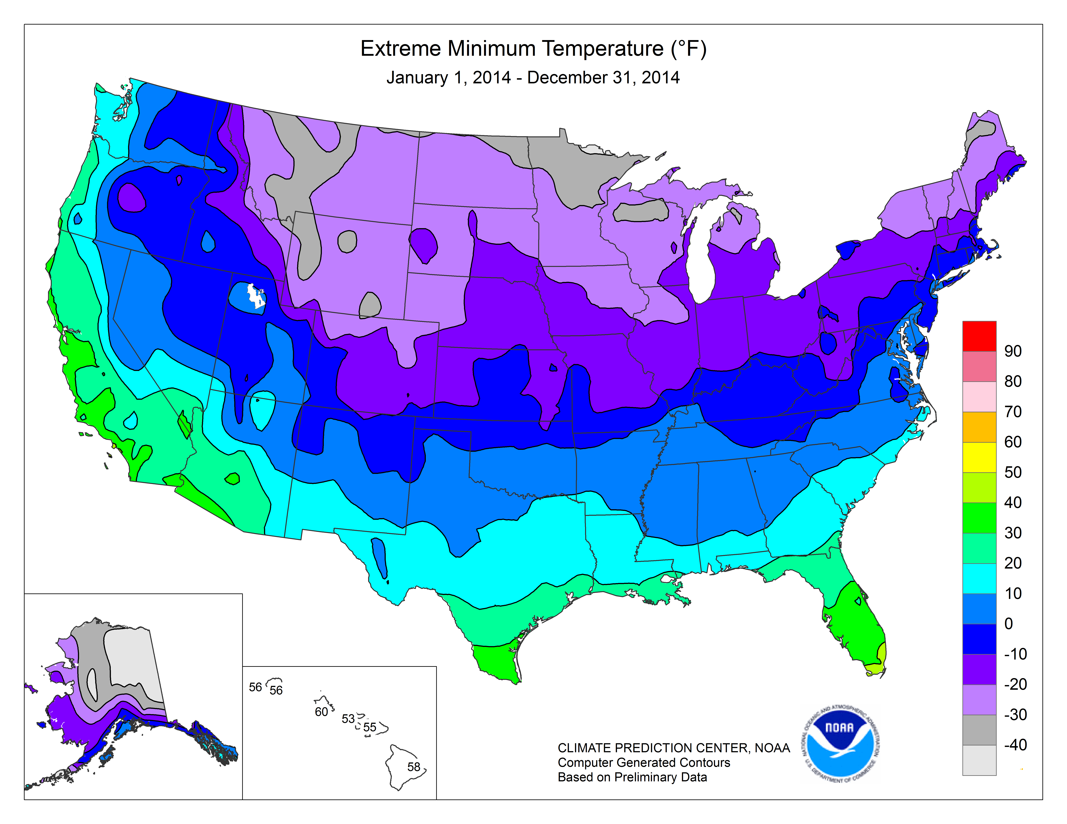
Climate Map from NOAA- Extreme Minimum Temp
Although VRF heat pumps operate at ambient temperatures as low as 0°F (–18°C), as in all heat pumps, their efficiency drops off considerably at low temperatures, so they are less cost effective compared to gas heating in very cold climates.- ASHRAE Journal April 2007
Any Areas below -10 F VRF will require supplemental heat, Duct Heater, Boiler or Steam!
Notes:
Any Area where the temperatures went below -10F a supplemental heater is necessary if they are operating in a system. You can live without HVAC you can’t without Heat!

Slide 23
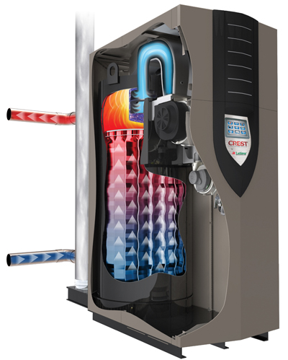
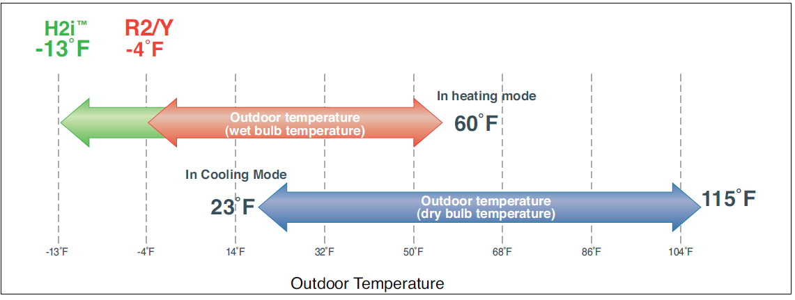
Options you have for heat on VRF?
Duct Heater
Boiler

Slide 24
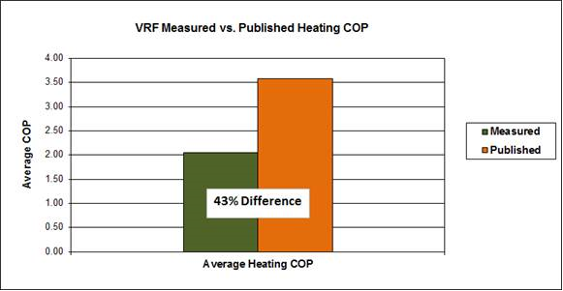
DOE-Inverter Driven HP in Cold Climate Study
During the Study It was quoted “The results from this monitoring effort show a wide range of performance with many systems performing below expectations.”
Two Manufactures in the Study

Slide 25
What Some VRF Mfg. Are Saying…
  VRF system technology eliminates most of the traditional limitations of DX split system such as piping length, turn-down, and ambient temperature limitations
    30% better efficiency than air cooled chiller - VAV air handling units- Really?
    30-50% better efficiency than traditional split systems -Really?
    50-70% better efficiency than PTAC and other types of systems- Really?
  VRF uses heat pump heating and eliminates the need for two systems (heating and cooling uses the same piping and heat exchangers)
  VRF allows building owners a solution that simplifies their HVAC system & reduces maintenance obligations WITHOUT sacrificing energy efficiency.

Slide 26
What VRF Mfg. Aren’t Saying…
VRF systems are completely proprietary systems from the controls to the condensing units, refrigerant controllers and all the system components- Only non Proprietary item is commonly used refrigerant piping.
NO flexibility to use “open source" building control and automation system to run these systems. (You can only monitor what it's doing but you can't control it.)
BacNet or Lonworks black box to the VRF through a building DDC system.
Higher First Cost for installation- Not always qualified companies due to first cost.
Education- Higher education required both Maintenance and Installation
Refrigerant Code ASHRAE 15- Life Safety!
Modification changes- Commercial Building TI ( Up fit ) work
Reference: Continuing Education and Development, Inc.

Slide 27
Take Away’s - Why are Engineers Choosing VRF?
Perceived New Technology- (New Shiny Toy Syndrome)
Equipment selection and design made easy by VRF Mfg.
  Software that will complete the design on behalf of the engineer
Millions of Marketing dollars spent to promote VRF in US
  Minimal dollars spent to promote Hydronic Systems as an industry
Miss Leading System Efficiency Comparison’s to Hydronic
  ECM on Compressors Vs ECM Pumps ( Apples to Apples)
Engineering Firm Turnover of Experienced Engineers
  Younger Generation without passed down Hydronic Knowledge
  VRF making it easy to cover gap- Software

Slide 28
PRINT ME !!!
ASHRAE Headquarters – In 2010 ASHRAE documented VRF consumed 56% more energy than Geothermal
Safety Concerns - Refrigerant leaks can be dangerous and even fatal in confined spaces.
Refrigerant Tubing - Refrigerant tubing piped throughout system results in potential massive number of joints required.
Installation Limitations - Piping can only be extended so far after splits.
Cold Weather Operation - Morning warm-up and backup electric heat can be very expensive.
Installation Costs - Initial component price and install can be more expensive than alternatives. Total First cost maybe higher. Qualify of Installation.
Pipe Insulation - Insulated HVAC Refrigeration copper pipes required to each zone.
Specialized technicians - required to startup, adjust, and repair systems. They are very limited in number- will “need to wait your turn”.
Efficiency is a function of outdoor temperature
  Reduced as the ambient temp goes up in cooling
  Reduced as the ambient temp goes down in heating
Complex oil management/recovery system - results in lost and reduced performance.
Reduced Efficiency long runs of pipe - system efficiency goes down based on length of refrigerant pipe runs.
No Standby on Multi-zone units - All zones on one compressor are down when service required.
Single sourced Controls and Parts - Each vendor has its own proprietary controls and are not compatible with other brands

Slide 29

Questions?

