Slide 1
Hydronic Solutions
electrification and decarbonization

Slide 2
Hydronic systems
– By design + hybrid opportunity
Central plants have multiple advantages
  Diversity – it means not everything “runs” at the same time
  It means there is less “purchased” horsepower
    The issues of electric service and distribution are addressed by design
    The owner has choice to match their requirements
  Commercial Buildings are Complex
Hydronic systems do not lose capacity due to “Climate Change”

Slide 3
Hydronics – any system which is water based – source or distribution
Today we are not concerned with why “electrification” only that it is a focus.
Today we will present the basics of the HVAC planning process
We will assume:
  You are an Asset Manager in the early planning process
  There is no final design for HVAC or Water Heating
  Your focus is the building requirements – we will help with HVAC
HVAC – Heating Ventilation Air Conditioning

Slide 4
Electrification defined
For electrification to be considered beneficial, it must meet one or more of the following conditions without adversely affecting the other two:
Saves consumers money over the long run;
Enables better grid management; and
Reduces negative environmental impacts.

Slide 5
Environmentally responsible HVAC
And Water heating
Use less Electricity
Use Less Fossil Fuel
Use less Refrigerant

Slide 6
The Environment – Hydronics addresses all the issues
Water is circulated not Wasted
GWP –
Water is ZERO
ODP –
Water is ZERO
Urban Heat Island effect – Water is ZERO
Refrigerant – Contained in Factory-sealed circuits
Efficiency is the purpose of hydronic systems
Demand is managed by design

Slide 7
Managing the “Grid”
Hydronic Systems use less energy
Predictability due to control of variables
Support accuracy in planning
  Electrical service required
  Backup sizing if power lost
  Sizing renewables
  Incorporation of Thermal Opportunities
Central Control logic and planning per open protocol

Slide 8
COST - installation and operation
Typical response will be
“It Depends”
Our goal is to help with direction to the team or individual
BUT first – what do you want?

Slide 9
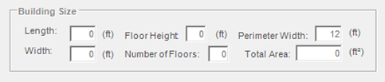
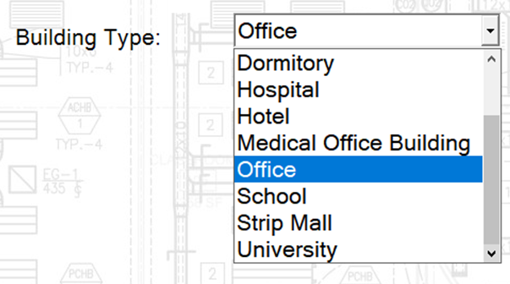
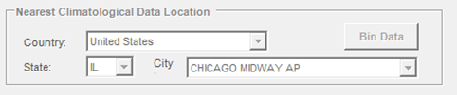
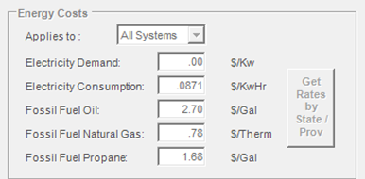
The building Function or
What is “Known”
Building Box Model
Building Type
Where is it?
How big is it?
What utilities are available – COST?
Bin Weather Data
Utilities and $

Slide 10
Building Type
What are the Owner’s Requirements?
Your requirements?
  People Comfort and security
  IAQ and IEQ – difference? A= air;
    E = environment (total building)
  Building and equipment conditioning
  Deliverables – Comfort to control
  Return on Investment
  Resilience and Sustainability
Above together determine – “LOADS”
  Not your concern
Indicates some System requirements
  What are the choices?

Slide 11
Hydronic Systems deliver
The primary goal gets back to Energy Efficiency
  It is not OK to waste renewables
  It is not OK to not meet owner requirements
  It is not OK to try and make one solution fit
  It is not OK to use more energy
The Hydronic System solution has always been about using less energy – electric or fossil fuel
Hydronic Systems are more than radiant floors or radiators

Slide 12
So, what can a hydronic system do?
First, they can be all electric
  Water source heat pumps and reversing chillers
    Reliable and capable
    Not new concept but more OPTIONS
      a lot of new product
      A hydronic central system with central or unitary choices
      Boiler and New Adiabatic tower
      100% ground source to hybrids
      District Ambient temperature Loops or community renewables
  Electric boilers and new gas boilers
    Staging and controls, backup?
  Hydronic Systems are designed for low energy use
  and the budget

Slide 13
How to “talk” about CHOICES
What if you had an HVAC Wizard?
Multiple Wizards:
Building Type
HVAC
Cost Estimating
A TOOL – software where you enter
“KNOWNS”
And click “GO”
system type

Slide 14
A Tool that shows Answers and the Questions
What questions?
Building size, where located
Program makes assumptions for your team to change
  Totally confidential
  Anyone can do it – download and click on “GO”
  4 Typical HVAC systems – a wizard to 30 systems
  All the components by type and efficiency ratings
  Loads per square foot
Each System output shows what selected and energy consumption

Slide 15
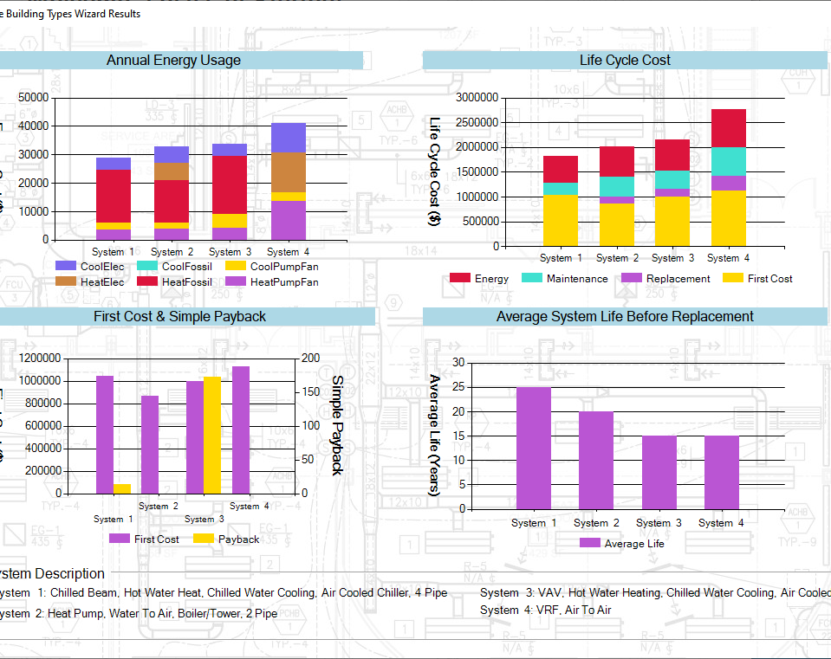
“GO” shows you 9 color reports
Gives you a template for budgeting
Compares multiple systems instantly
Allows all components in system to be electric monthly annually
Life Cycle Cost

Slide 16
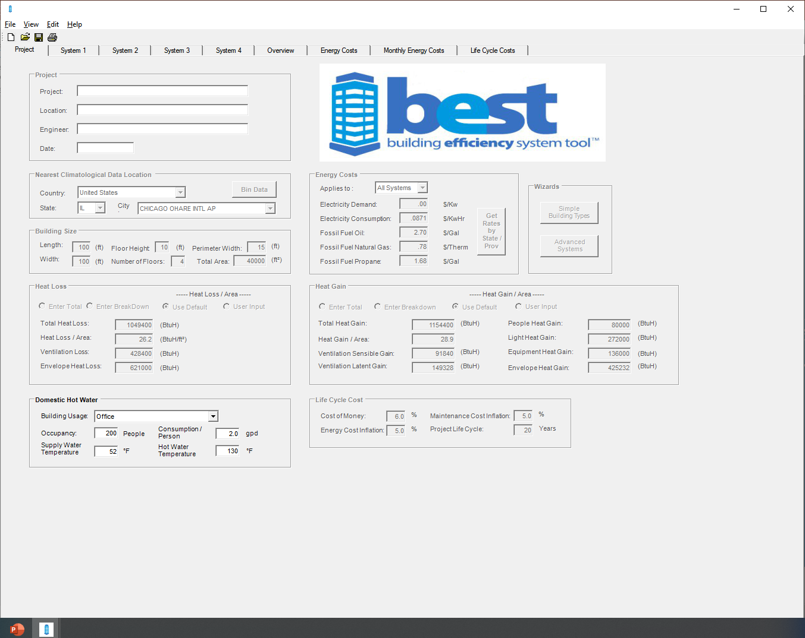
The purpose of the Building Wizard is a place to “Start”
You entered “knowns
The program defaults everything else
The output is a “start”
Almost everything is changeable
Tutorials at www.besthvac.org – free
Why did HIA-C provide this program
Hydronic systems are all about choice
We welcome comparisons
There is no single answer
Because of Hydronic System advantage

Slide 17
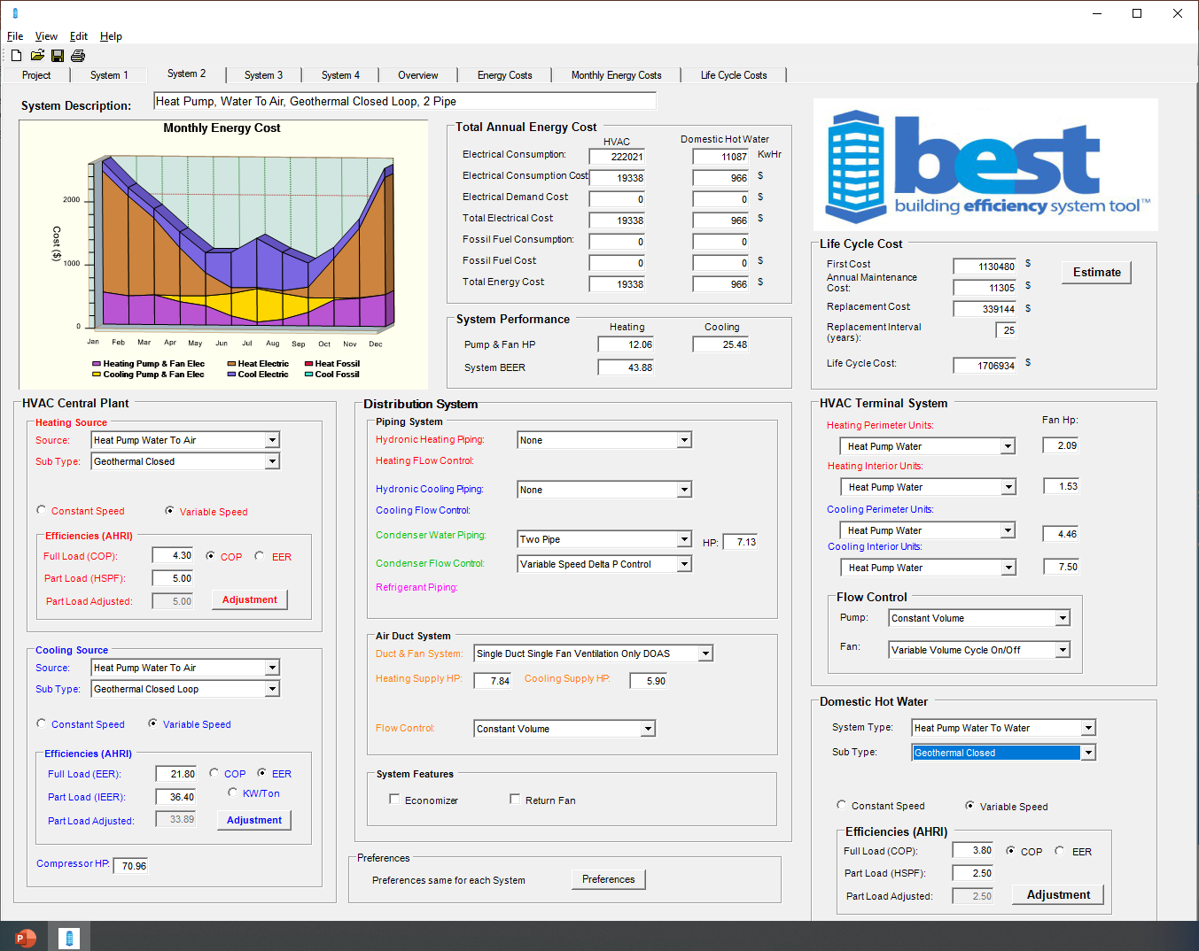
Hydronic System advantages
HVAC and Water heating at lowest COST$
System cost is made up of 3 primary functions
The Central System reduces Horsepower
Hydronic Components use less fuel
Technically and as applied
Capability and control
Whole building logic – to zone logic
Distribution System
Btu’s move in pipe at the lowest cost
at 10% of options like duct or refrigerant tubing
Terminal System – multiple options
The Central Plant delivers the efficiency purchased and maintains performance

Slide 18
Electrification
Is cooling an answer to heating?
A problem with decarb is
Water heating
Energy efficiency
Grid management
Environmentally responsible
No cost penalty – or minimized
Hydronic central system addresses all the above in cooling
Hybrid solutions and Thermal Opportunities
  AND Heating

Slide 19
Cooling we take for granted as Electricity or, what about-
“Thermal Opportunities”
What about heating?
  Electric boilers
  Solar thermal
  New investment in technology
  District solutions
But I have natural gas and I like the costs and performance
Decarbonization
  means use less or is it none?
let’s look at some options to decarb…

Slide 20
What is the by-product of “cooling”
It is the heat removed from the building plus?
  Plus + plus what?
    The compressor energy consumption is part of the heat rejected in cooling
    It is part of the reason for “Urban Heat Island Effect”
    It is why higher efficiency cooling is important
      The building heat is the load
      The plus, is directly a product of cooling compressor efficiency
  Opportunity – “Cooling as an answer to heating”
    Hydronic systems use less compressor energy
    Hydronic systems provide the opportunity to recover the “HEAT”
      Not a separate system
      Not just HVAC but water heating as well
      Not just a zone – the whole building
      Not just a building but multiple buildings
      – District ATL’s – Environmental Neighborhoods

Slide 21
First use less – and What about heating? Heating water is a barrier to electrification – Hydronic Systems enable Decarbonization Multiple ways.
Reclaim – the heat you are wasting with air-cooled unitary
Central Hydronic Systems
The power you bought in cooling is reclaimed
The power is yours - use it
If you are heating water for HVAC or Domestic
You just turned electrification into decarbonization
“Electrification and decarb” - less at source and site
Legislated does not affect you if gas is not in the street or fuel is NOT delivered
Electrification can affect you if your building uses fossil fuel
Service
Distribution
The Grid capability and reliability
Either or Both –
THE key is use less – environmental responsibility

Slide 22

Hydronic Central Systems
Otherwise, it is gone
Benefits – Energy Efficiency and the Environment
Hydronic cooling is 30-40% more efficient than air-cooled product
Even when made by the same manufacturer
May be 70% more efficient than old equipment
Reduces cost and use of “NEW” fuel
There is no addition to “urban heat island effect”
The GWP of water is ZERO, there is no ozone depletion factor
Primary benefit – Take control of HVAC and Water Heating at the lowest Cost

Slide 23
Hydronic System – tried and True
More to come
Let’s talk variable and lift – strategies for both heating and cooling
Let’s talk integration
Let’s talk ventilation, humidity control and filtration
  Let’s talk cross contamination of air flow
  Let’s talk individual space air flow direction
  Let’s talk system to fit activity
Let’s talk energy sharing – community renewables and thermal opportunities
Let’s talk system life – without it there is no ROI
Let’s talk competition and long-term costs – forward and backward compatibility
Let’s talk resilience – requires options and choice - proprietary kills resilience
Let’s talk the budget – Owner requirements first, system capability to perform and choices
Let’s talk about demand control - predictability is control of variables
Let’s talk about sustainability and reducing the use of refrigerant
Let’s talk about district solutions and energy efficiency for all

Slide 24
Hydronic Solutions
The NEW concepts
Visit the Hydronic University www.hia-C.org
PIPE – fast and furious forever
PUMPS – smart and a choice for every need
Systems – designed to deliver
All about delivering the requirements of the owner at the lowest cost
  Faster
  Simpler
  Predictable
Hydronic systems and renewables
  Sizing
  Interface
  Resilient
  sustainable

