Slide 1
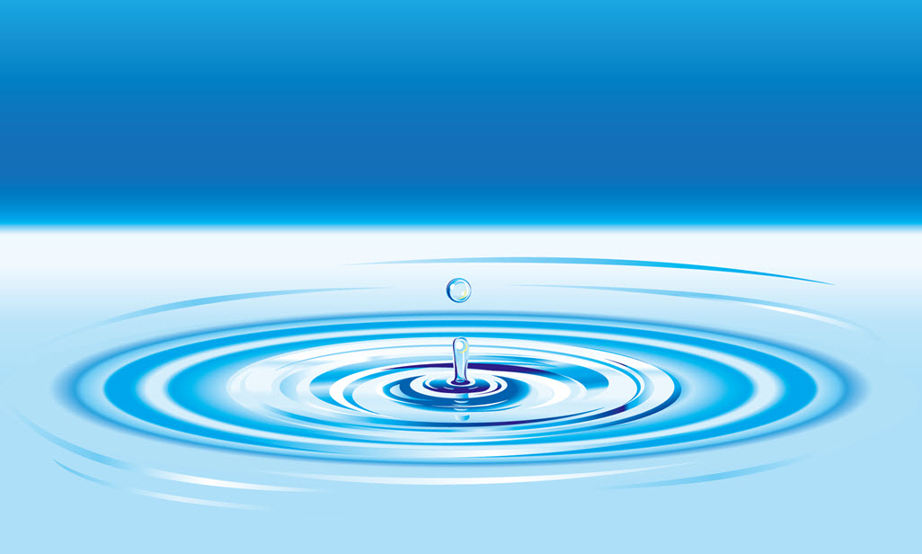

HYDRONIC HVAC:
The Most Comfortable and
Efficient System
Notes:
Thank you for visiting our website. Multiple manufacturers of hydronic system components have come together to explain and integrate the advantages of using water as the medium for heating, cooling, and energy sharing.

Slide 2
HVAC Design Goals
#1 – Reduce building load
  Building orientation, construction, and integrated design
#2 – Demand control ventilation
#3 – Net Energy Use (energy sharing)
  Recycle, reclaim, integrate
    Example cooling to heating ventilation air or hot water
#4 – Extend equipment life
#5 – Reduce cost of delivering Comfort
#6 – System efficiency not unit efficiency ratings
  Efficiency ratings are at static conditions
  Not valid from one type of equipment to another
  Test points versus applied efficiency
Notes:
We have realized that in response to sophisticated design requirements in North America, the building owner supplies heating, ventilation and cooling throughout the commercial building. In other parts of the world, cooling is strictly the tenant’s responsibility. That is the only reason why unitary variable air-cooled options can be touted as better than conventional single-speed unitary options, neither of which is as efficient as a water-based system. Even our own members state that identical components average 30 percent higher efficiency when water-cooled versus air-cooled. There are multiple additional reasons, which we will address.

Slide 3
How to mitigate operating cost?
  Once load exists!
  Water-cooled equipment is more efficient and lasts longer
    Why?
      Heat transfer is better
      kW consumed is the lowest
      The building system operates against design
        Design? Yes, operating temperatures are controlled
        Not outside air temperature which varies widely and creates the “triple penalty”.
        Lower efficiency
        Lower capacity
        and shorter life
Notes:
We also know that supplying information to the mechanical professional leads us to details of components — not whole-building systems. The result of a hydronic design is that all building loads are tied to a controlled system using water. The equipment does not work as hard. Your energy bill is isolated from the negative effects of outdoor air temperatures on system efficiency and capacity — right when demand and rate charges are highest. Equipment that uses water as the medium lasts longer, so every economic analysis includes lower cost of replacement maintaining your investment in comfort.

Slide 4
Reduce operating cost
Moving Comfort around building has associated cost
  Water (Hydronic systems) has the lowest cost & longest life
  Air in duct is second – but necessary
  Refrigerant piping has the highest cost penalty
    Why?
      Loss of compressor efficiency to pumping cost – Lift + Length
        Unit efficiency drops 30-40% when compressor has to move refrigerant around building
        Oil management cycle and defrost waste energy
        Refrigerant is best contained in factory sealed and certified circuits – avoid field piping losses
        What happens when refrigerant changes?
        System Units, piping, and controls replaced
        Kills all life cycle calculations.
Notes:
Our intent as a committee formed under the RPA is to address central hydronic system solutions and benefits.
When equipment is applied to a building, only a central hydronic system actually maintains and improves component performance and life. There is nothing wrong with variable compressors or factory-sealed refrigerant, as hydronic systems benefit from using both. It is the increase in a system’s operating costs where we see piping large amounts of field-installed refrigerant destroy performance. That action can triple the amount of refrigerant in a building. This requires refrigerant leak detectors, and those systems are all proprietary. We provide proof of this issue throughout the reference materials and case studies.

Slide 5
Net Energy –
System versus unit efficiency
Two buildings have the same load – but the Hydronic System always wins due to reduced energy use. Why?
Lowest operating cost, PLUS:
Simultaneous heat reclaim – Lowest cost, when applied to the whole building design for increased opportunity to share energy
CYCLICAL – Better practice, heating and cooling offset each other but do not have to occur simultaneously
Available only with hydronic systems
Storage – Best practice based on cost
Available only with hydronic systems
Notes:
The simplest unit efficiency rating is the EER – energy efficiency ratio – tested at a fixed operating point. With water-cooled equipment, that point is at a maximum operating point. For air-cooled equipment it is at an 80-90 percent point. The residential industry adopted an efficiency rating with “Seasonal Adjustments,” the SEER. The VRF industry is promoting itself based on an “integrated” or part-load tested performance, the IEER. Both alternatives are relevant when comparing like units only. A comparison is of marginal value when comparing different system types, or as applied, and of little value when comparing air-cooled equipment to water-cooled equipment. Measuring “water” system components at a maximum point and the others at part load simply yields misleading numbers. Certifying performance at a maximum point is why water-based systems will always deliver when it comes to the utility bill.

Slide 6
Applied Hydronics = lower cost
Limit fan horsepower
  Demand controlled ventilation
  Radiant heating and cooling eliminates fan horsepower
Hydronic System advantages
  Lowest pump horsepower
  Higher efficiency – source temperatures are designed
  Longer life – equipment does not “work” as hard
  Integrated solutions to other building systems and renewables
  Factory sealed and certified refrigerant circuits
  Forward and backward compatibility - sustainable
  Competitive bidding for the life of the building
  Does not become obsolete when refrigerant changes
Notes:
We are addressing multiple benefits, with a major one being sustainability. In many cases, members of this committee are direct competitors, and with that another advantage to the owner becomes one of the single most compelling reasons to go hydronic. We compete in the initial installation, and we compete for service, replacements, and upgrades to the system for the life of the building. When refrigerants changed our components were factory certified and sealed. Components could be changed out without impacting the other system components. Typically the change improved system efficiency. Hydronic systems are not proprietary; they are compatible, upgradeable, and sustainable for the life of the building.

Slide 7
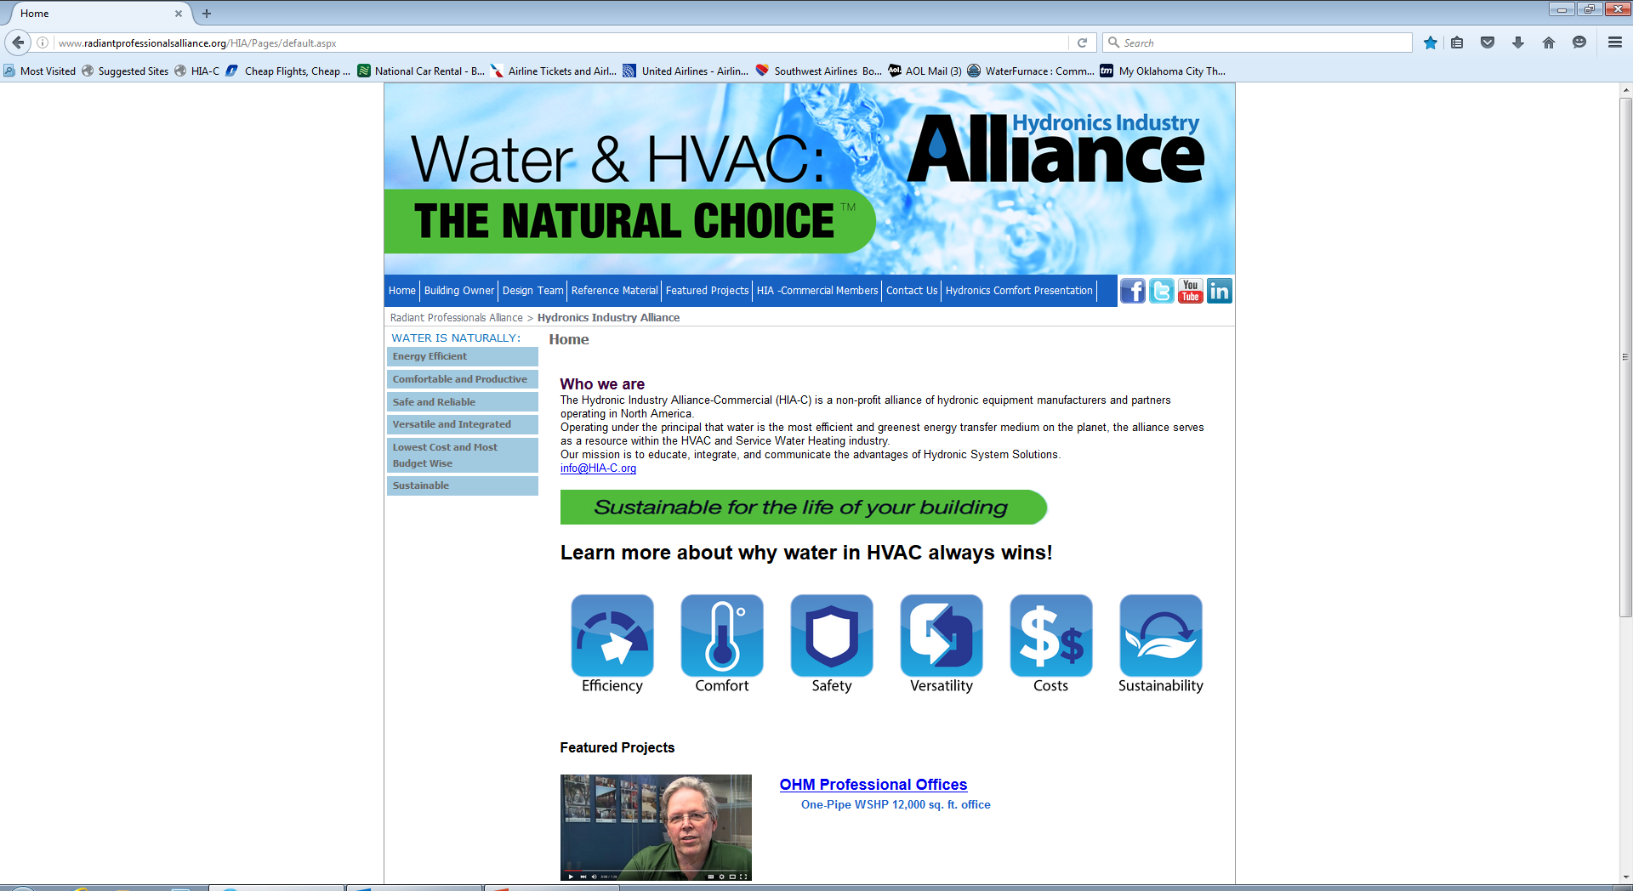
Notes:
The hydronic industry has been developed with the goal of enhancing competition and choice. Each of our members has focused primarily on his or her part of the system, but this committee is focusing more on your needs. The world uses water to regulate temperature. A hydronic central system circulates water around your building for both temperature control and energy sharing.
Please see our core values below and do not hesitate to contact any of our members.
Thank you very much.

