Slide 1

VRF and Building Owners
What you need to know before investing in an HVAC System.

Slide 2
Today’s Buildings
"We no longer build buildings like we used to, nor do we pay for them in the same way. Buildings today are...life support systems, communication terminals, data manufacturing centers, and much more. They are incredibly expensive tools that must be constantly adjusted to function efficiently. The economics of building has become as complex as its design." (Wilson, in foreword to Ruegg & Marshall, 1990)

Slide 3
“Every Owner Wants a Cost Effective Building.”- What does that mean?
Is it the lowest first-cost structure that meets the program?
Is it the design with the lowest operating and maintenance costs?
Is it the building with the longest life span?
Is it the facility in which users are most productive?
Is it the building that offers the greatest return on investment?
https://www.wbdg.org/design/cost_effective.php

Slide 4
Office Space Classes- BOMA
Class A- 67%
Most prestigious buildings competing for premier office users with rents above average for the area. Buildings have high quality standard finishes, state of the art systems, exceptional accessibility and a definite market presence.
Class B- 30%
Buildings competing for a wide range of users with rents in the average range for the area. Building finishes are fair to good for the area. Building finishes are fair to good for the area and systems are adequate, but the building does not compete with Class A at the same price.
Class C-3%
Buildings competing for tenants requiring functional space at rents below the average for the area.

Slide 5
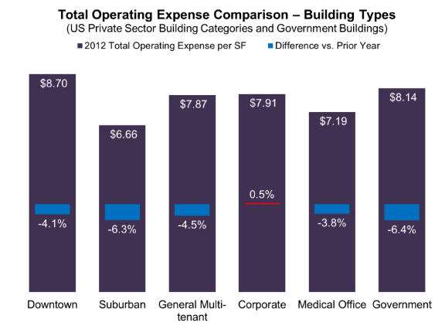
BOMA- 2012 Operating Expense

Slide 6
Building Large Cost items
Life Safety
  Elevators
  Fire System
Roof
HVAC
Focus for todays presentation

Slide 7
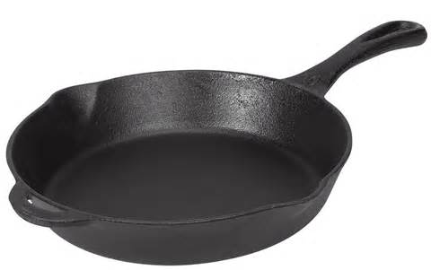
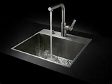


Question: Cooling a hot skillet - What is Faster?
Water- 100 degree dishwater
Wave around in
70 degree air

Slide 8
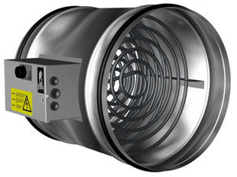
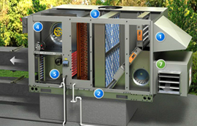
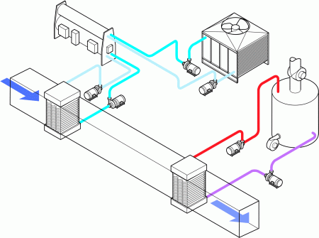
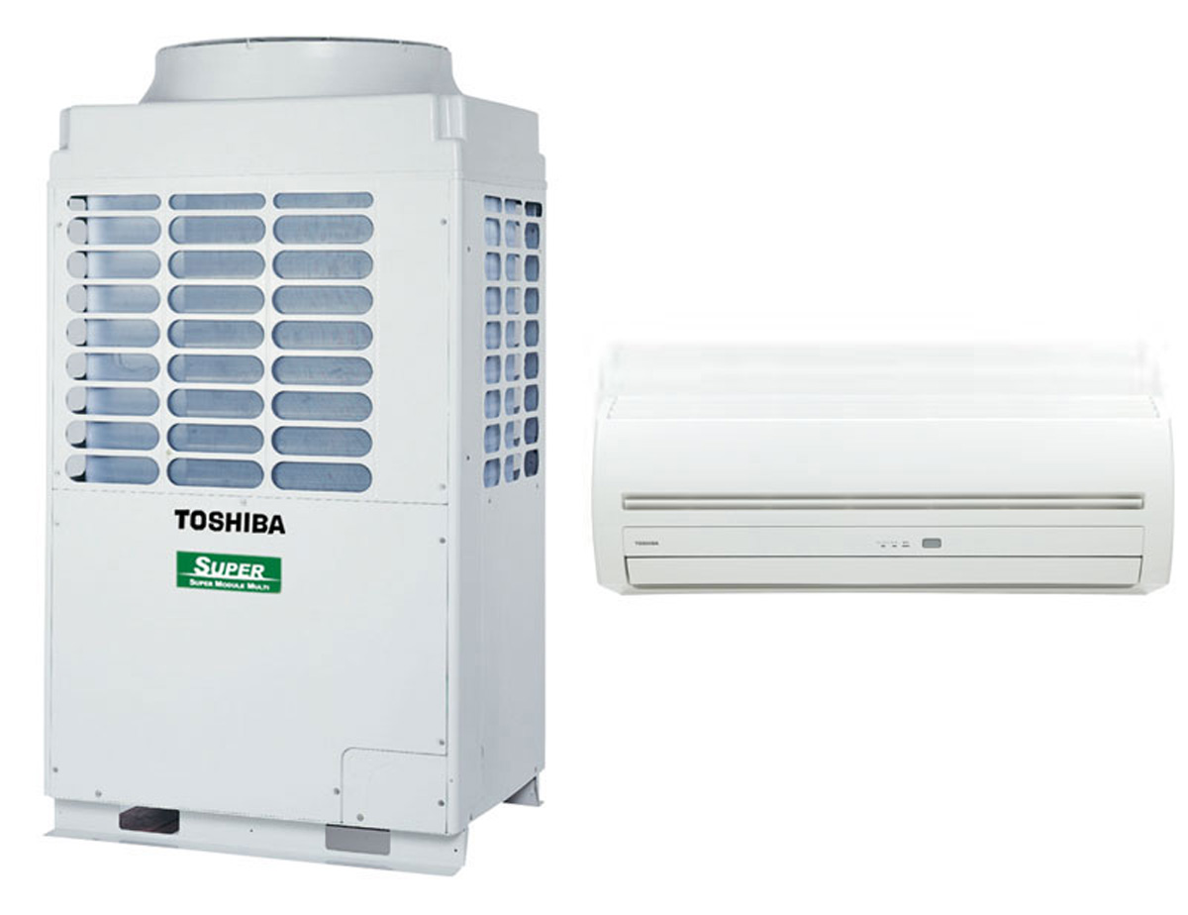
HVAC –VRF compared to Hydronic systems
VRF IS ONLY ANOTHER OPTION!!! Not the Answer to Everything!
DOAS System
(Dedicated Outdoor Air System)
Hydronic Air Handler

Slide 9

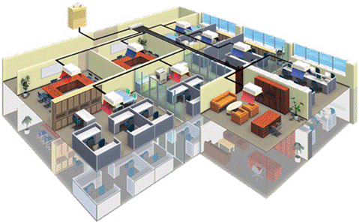
What is VRF?
Definition of VRF systems: ASHRAE 90.1-2013 Standard
Variable-Refrigerant-Flow (VRF) system: an engineered direct expansion (DX) multisplit system incorporating at least one variable capacity compressor distributing refrigerant through a piping network to multiple indoor fan-coil units, each capable of individual zone temperature control, through integral zone temperature control devices and common communications network. Variable refrigerant flow utilizes three or more steps of control on common, interconnecting piping.

Slide 10





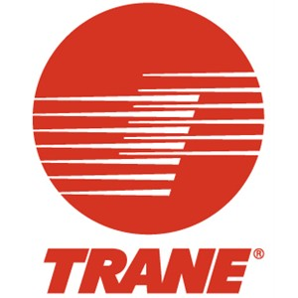
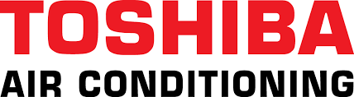


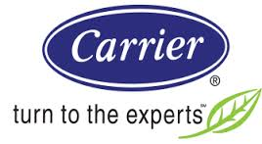


VRF Current Manufactures
A Typical VRF System is between 3-30 tons per unit.

Slide 11
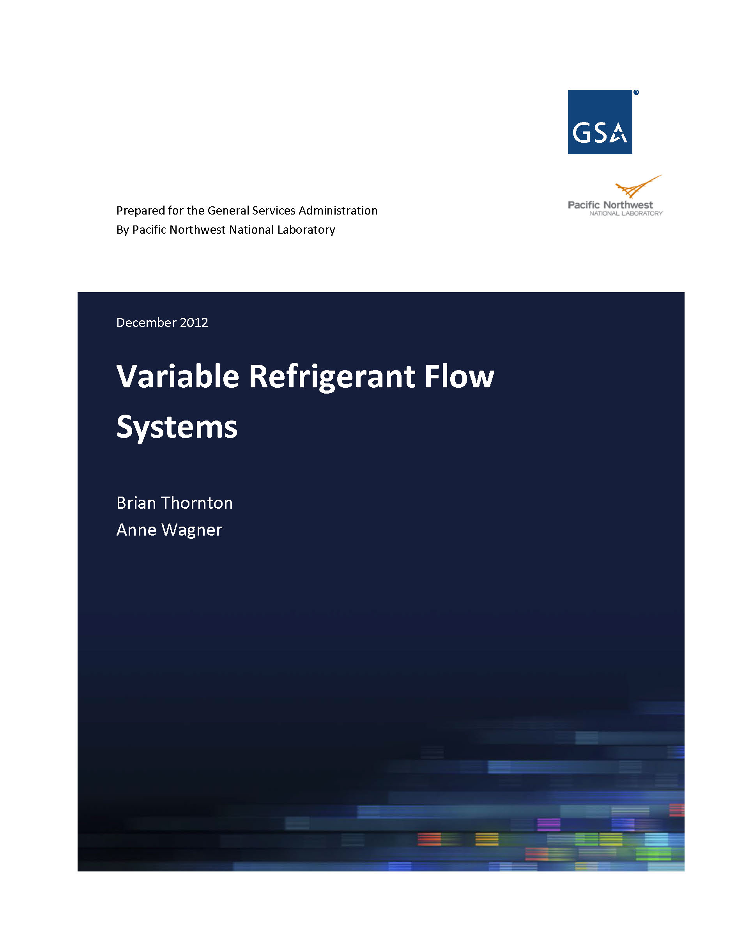
Recommendations to GSA…

Slide 12

VRF Building Sizes........
What was suggested to the GSA by a Pacific Northwest National Laboratory?
Under 5,000 ft² to 10,000 ft² may be less suitable because there are substantially less expensive alternatives than VRF. Above 80,000 ft² to 120,000 ft², other alternatives, such as VAV chilled water and hot water reheat systems with high efficiency plant equipment, and controls consistent with ASHRAE Standard 90.1-2010, may be more cost-effective.
Sweet Spot for VRF is 15,000ft²- 60,000ft²
Does not mean VRF could not be installed in the 80,000ft² and up!!!
In Japan, VRF systems are used in approximately 50% of medium-sized commercial buildings (up to 70,000 ft² [6500 m²]) and one-third of large commercial buildings (more than 70,000 ft² [6500 m²]).- ASHRAE Journal April 2007

Slide 13
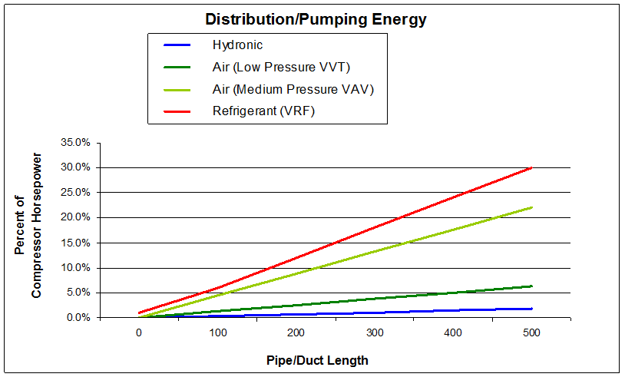
15,000 sqft- 60,000 sqft HVAC System Breakdown

Slide 14
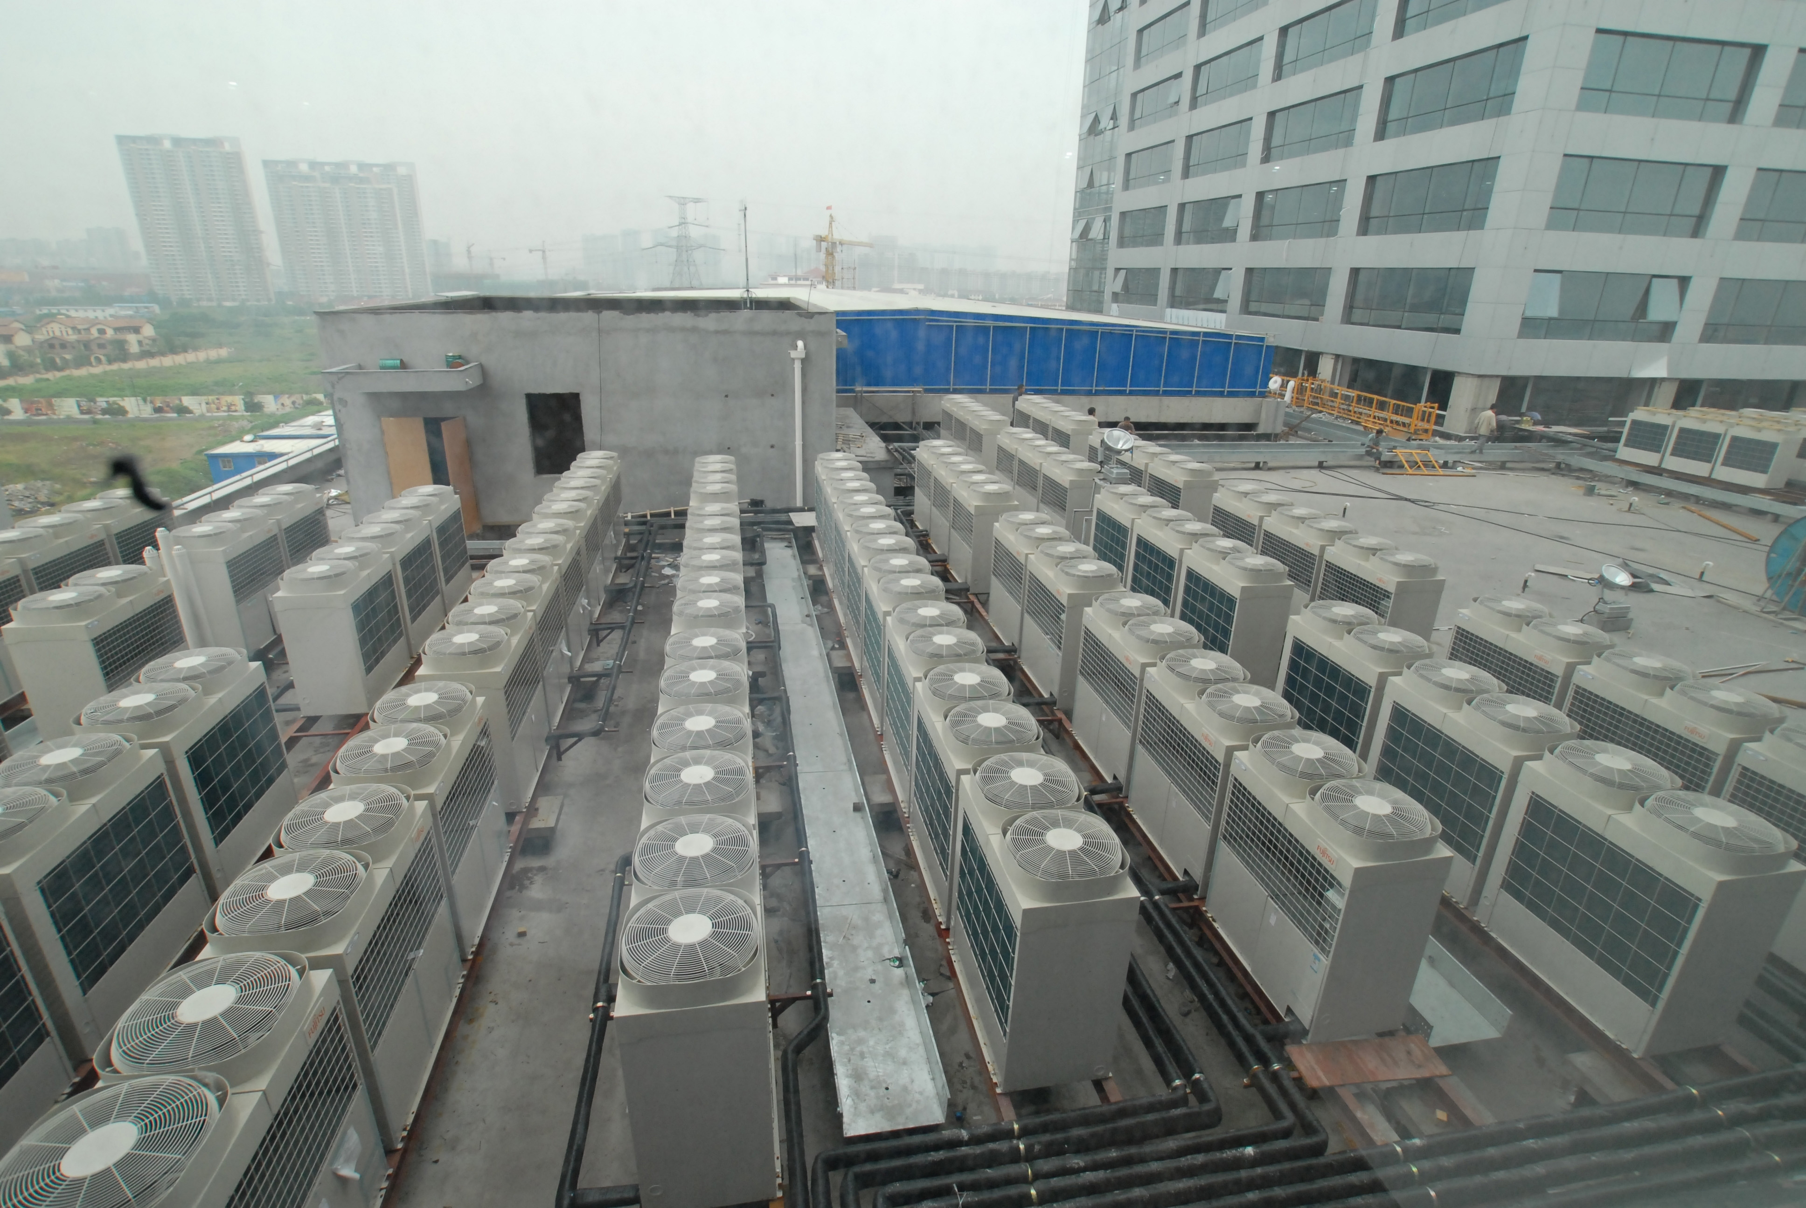
You’ve got a leak and how many roof penetrations?

Slide 15
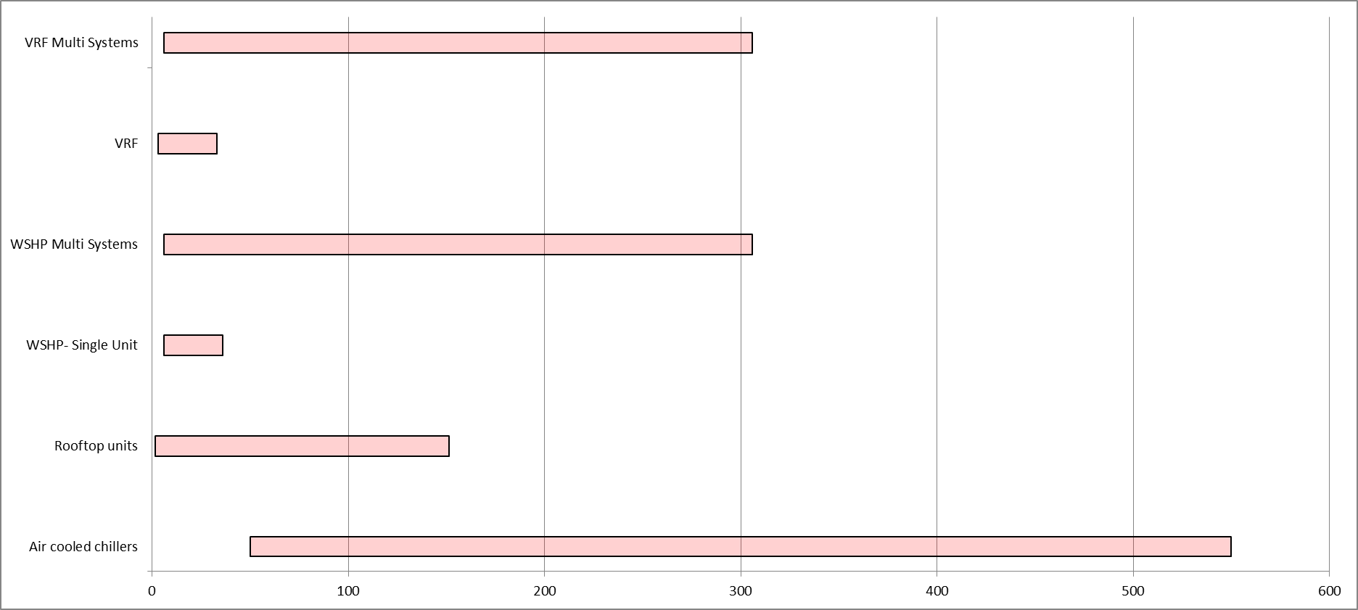
VRF Cross over Tonnage Map

Slide 16
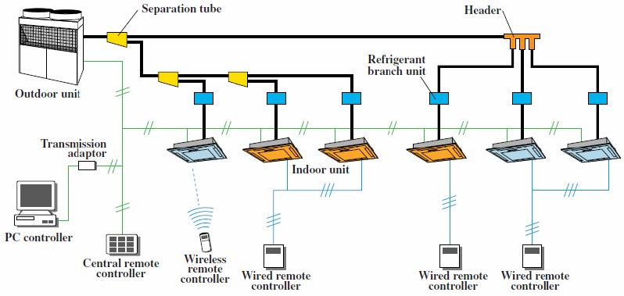
VRF system – How does it work?
Notes:
Ask what is the only nonproprietary item in the system?

Slide 17
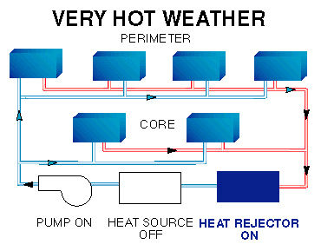

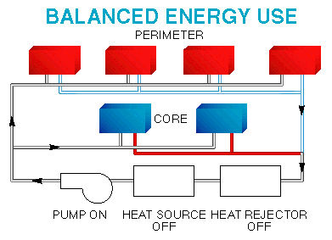
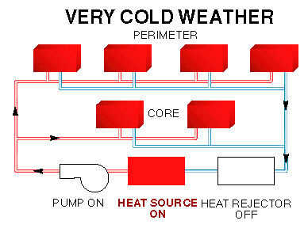
WSHP System with boiler- Hydronic System
WATER IS A BATTERY!!!
Hot Humid Temperatures
Below Zero Operation!
Loop Temperature Range: 50F – 110F

Slide 18
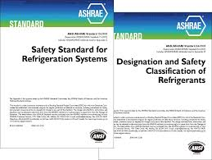
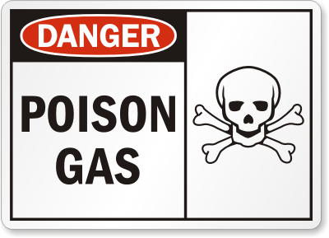
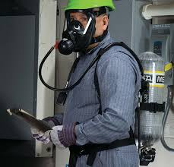
ASHRAE 15 and 34 Standard- VRF
Why is ASHRAE 15 and 34 so important when applying to VRF?
Large Amounts of Refrigerant in Occupied Space
LIFE SAFTEY!!!
May Cause Building Space Redesign!

Slide 19
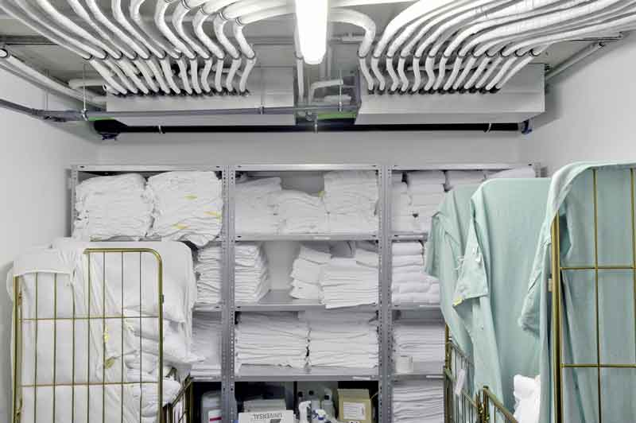
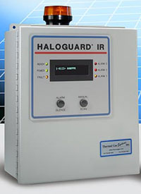
VRF system –ASHRAE 15- Ref Standard
VRF systems must comply with ASHRAE Standard 15-2013 - Safety Standard for Refrigeration Systems (ANSI approved).
Few VRF manufacturers have developed products and protocols to address the concerns of refrigerant leakage.
Operating Pressures of R-410A
High Side: 418 psig
Low side: 130psig

Slide 20
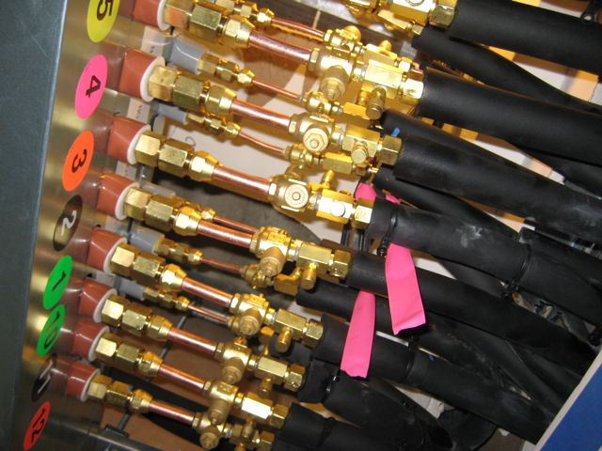
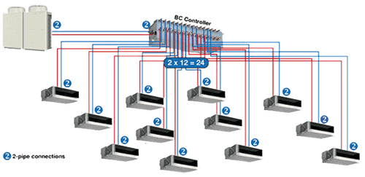
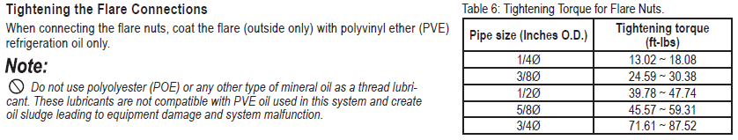
VRF system –ASHRAE 15
How would you like to Leak Check these connections?
Testing Pressure in VRF System: 551 PSI!!!
Hydronics (Pressures of 30-40 PSI Typically)

Slide 21
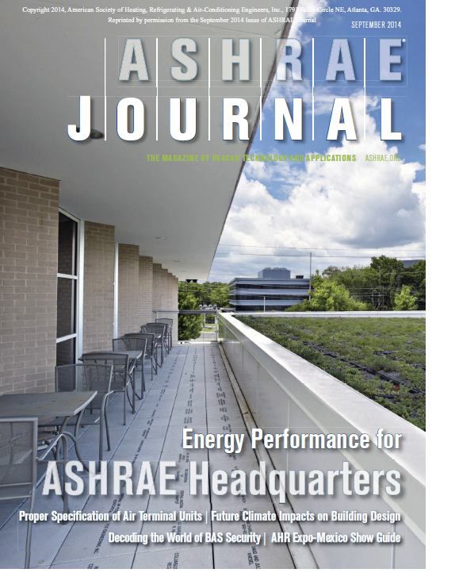
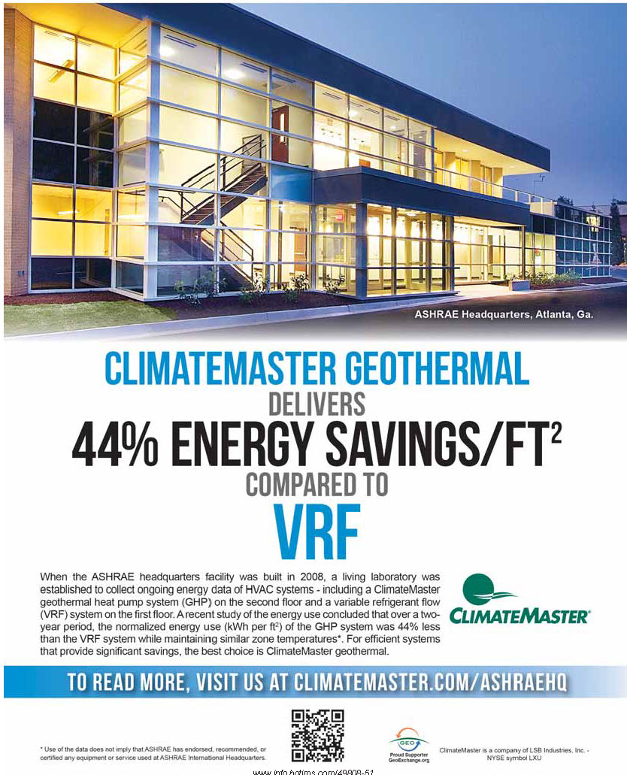
ASHRAE- Atlanta Case Study
Courtesy of the ASHRAE Journal – September 2014 edition

Slide 22
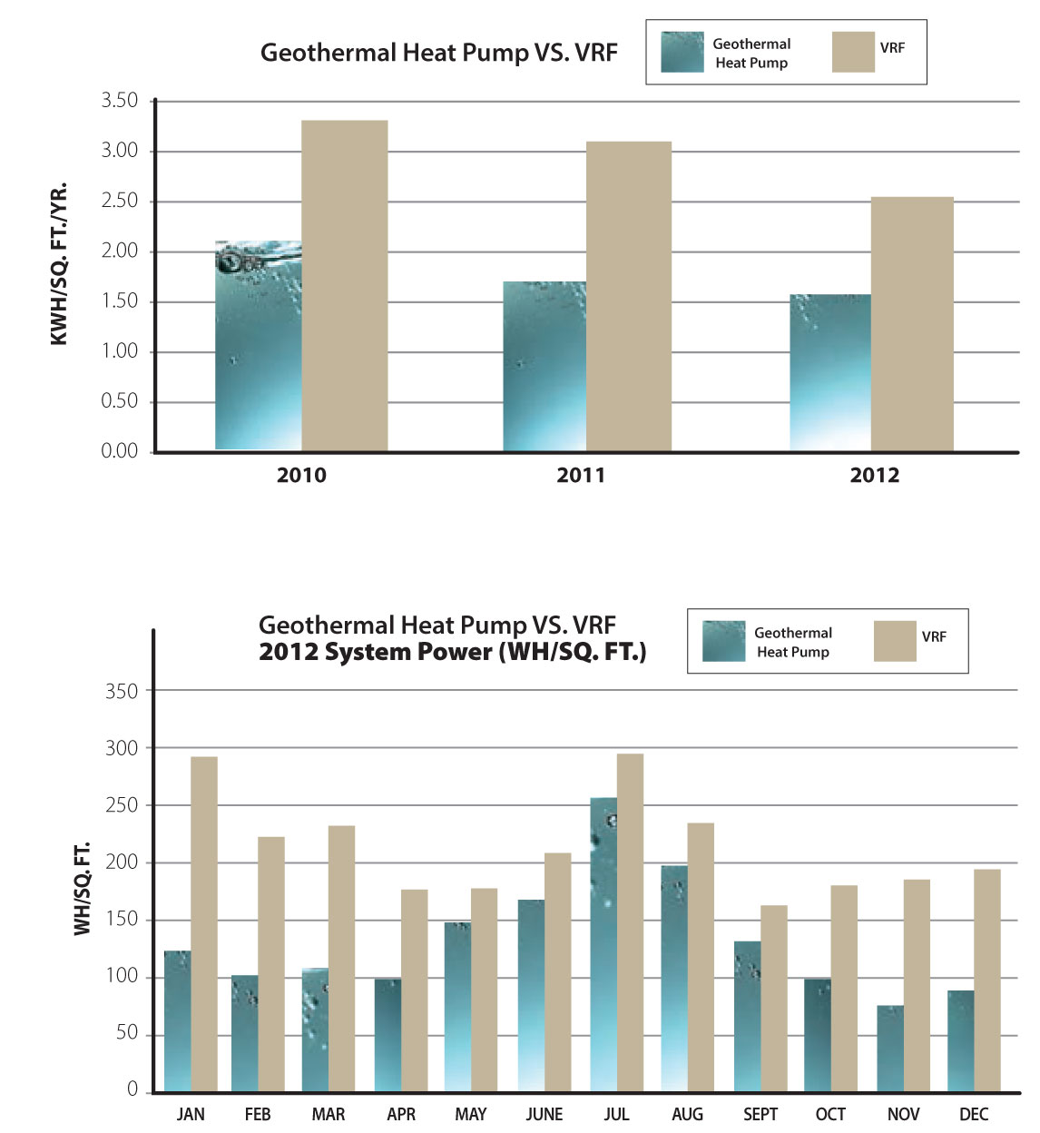
ASHRAE- Atlanta Case Study
ASHRAE’s Conclusion
The ASHRAE headquarters living lab is a valuable
resource of information regarding the real performance
of high efficiency HVAC systems in an operational office
building environment. The efforts described in this
article have barely touched the surface of the vast opportunities
that are available to researchers through this
resource.
During the two-year period that this study encompassed
the GSHP system used about 20% and 60% less
energy than the VRF system in the summer and winter/
shoulder seasons, respectively, while maintaining similar
zone temperatures. Factors contributing to the differences
in energy use include:
Ground loop water supply temperatures were more
favorable than ambient air temperatures for heat pump
operation. This allows the GSHP equipment to operate at
higher efficiencies.
The control strategy of the VRF system resulted in longer
runtimes than the GSHP system, especially in mild
weather. These longer runtimes coincided with significant
amounts of simultaneous cooling and heating in
adjacent spaces.

Slide 23
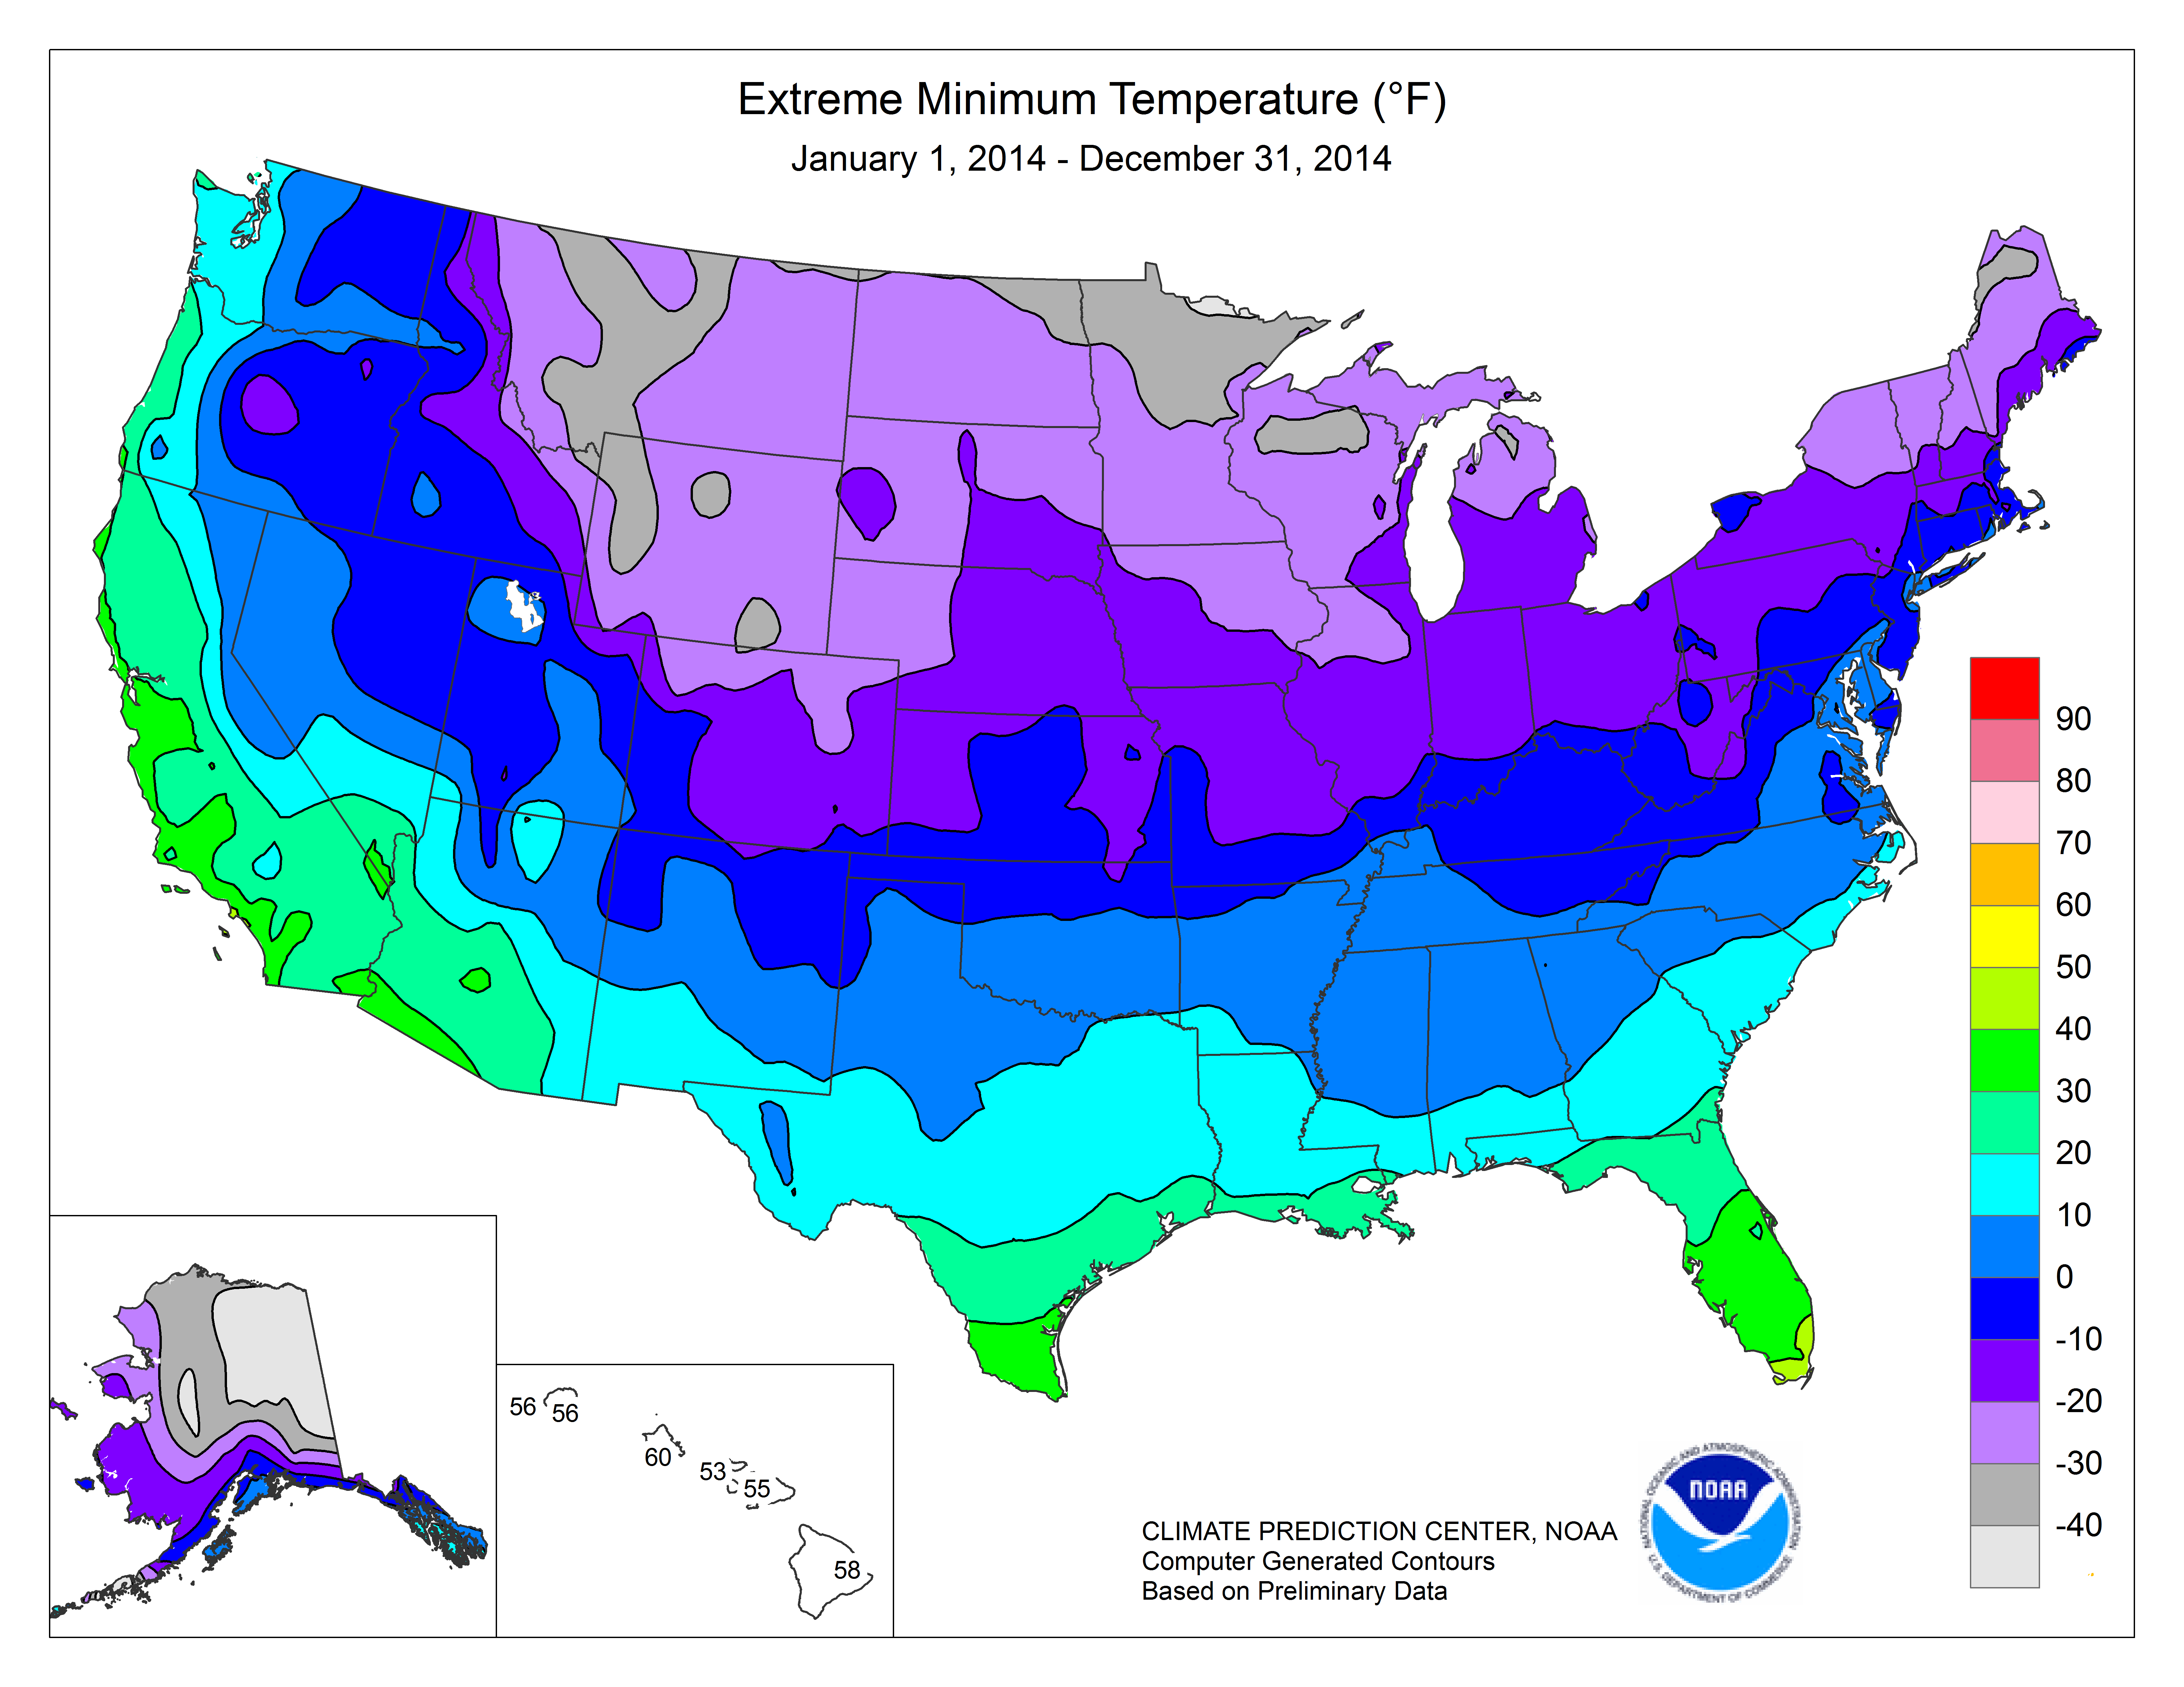
Climate Map from NOAA- Extreme Minimum Temp
Although VRF heat pumps operate at ambient temperatures as low as 0°F (–18°C), as in all heat pumps, their efficiency drops off considerably at low temperatures, so they are less cost effective compared to gas heating in very cold climates.- ASHRAE Journal April 2007
Any Areas below -10 F VRF will require supplemental heat, Duct Heater, Boiler or Steam!
Notes:
Any Area where the temperatures went below -10F a supplemental heater is necessary if they are operating in a system. You can live without HVAC you can’t without Heat!

Slide 24
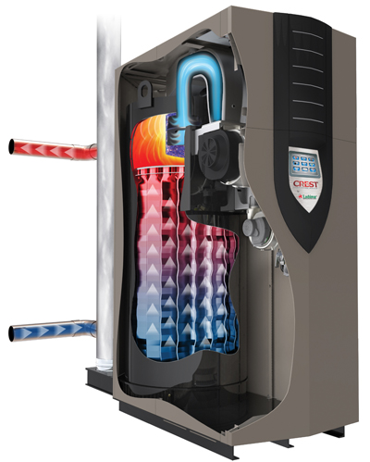
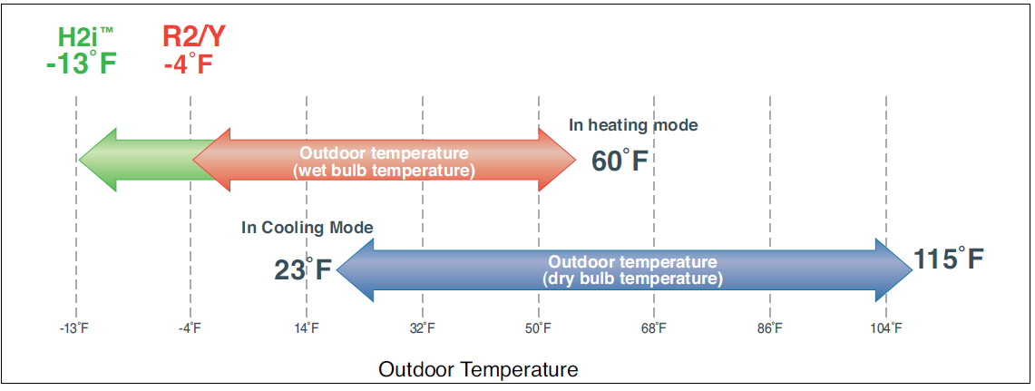
Options you have for heat on VRF?
Duct Heater
Boiler

Slide 25
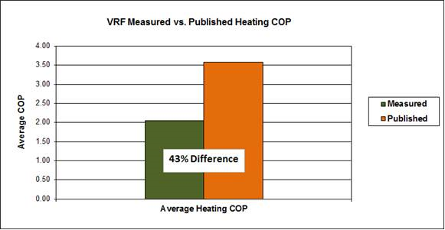
DOE-Inverter Driven HP in Cold Climate Study
During the Study It was quoted “The results from this monitoring effort show a wide range of performance with many systems performing below expectations.”
Two Manufactures in the Study

Slide 26
What Some VRF Mfg. Are Saying…
  VRF system technology eliminates most of the traditional limitations of DX split system such as piping length, turn-down, and ambient temperature limitations
    30% better efficiency than air cooled chiller - VAV air handling units- Really?
    30-50% better efficiency than traditional split systems -Really?
    50-70% better efficiency than PTAC and other types of systems- Really?
  VRF uses heat pump heating and eliminates the need for two systems (heating and cooling uses the same piping and heat exchangers)
  VRF allows building owners a solution that simplifies their HVAC system & reduces maintenance obligations WITHOUT sacrificing energy efficiency.

Slide 27
What VRF Mfg. Aren’t Saying…
VRF systems are completely proprietary systems from the controls to the condensing units, refrigerant controllers and all the system components- Only non Proprietary item is commonly used refrigerant piping.
NO flexibility to use “open source" building control and automation system to run these systems. (You can only monitor what it's doing but you can't control it.)
BacNet or Lonworks black box to the VRF through a building DDC system.
Higher First Cost for installation- Not always qualified companies due to first cost.
Education- Higher education required both Maintenance and Installation
Refrigerant Code ASHRAE 15- Life Safety!
Modification changes- Commercial Building TI ( Up fit ) work
Reference: Continuing Education and Development, Inc.

Slide 28
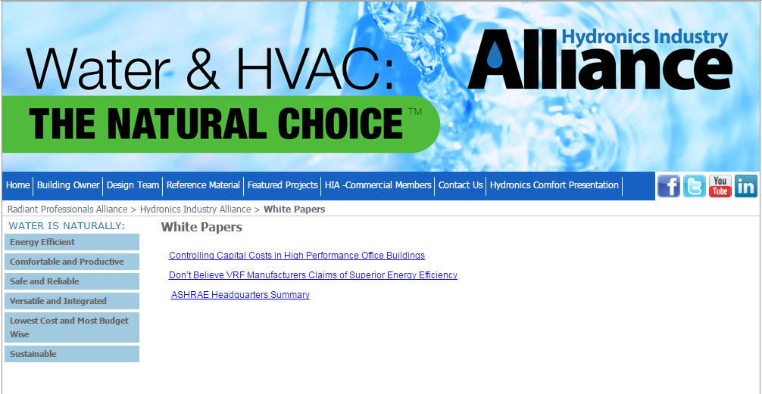
More Information- White Papers
www.radiantprofessionalsalliance.org/HIA

Slide 29

Questions?

