Slide 1

Water: The Natural Choice
For Efficiency
Unit efficiency versus Building System efficiency
Equipment Ratings
EER and COP
SEER
IEER vs IPLV
IEER is an integrated performance for a central chiller
Validity is possible because of diversity
All chillers would use the same raring points and conditions
IEER loses validity for unitary equipment when equipment is variable but load is not!

Slide 2


Unit Efficiency – Sustainable for life
EER is simple
Output of unit in BTU divided by input power
Every unit, a chiller, a rooftop, unitary equipment
that uses refrigerant has an EER
Energy Efficiency Ratio
EER is BTU per hour output in cooling/power input
Example a one ton unit delivers 12,000 Btuh/1000 watts for fan and compressor = 12 EER

Slide 3

Unit Efficiency (be careful) – Not a building
Why SEER and IEER?
Adjusted performance to show potential blended rating
Adjusted to include part load operation over a specific range of outdoor air temperatures
Because outdoor air temperature affects both capacity and efficiency of an outdoor condensing unit.
SEER – Seasonally adjusted used primarily for residential equipment
IEER – Integrated to include both seasonal and part load per formula
Problems
How to apply adjusted ratings to actual building
Operation of equipment outside ratings

Slide 4
SEER – why – Residential is more comparable
Applied residentially based on the fact that the majority of residential units are installed very similar. Actual varies by size, location and weather, but all are tested to the same weather so they can be compared to each other.
A condenser outside
An air hander inside
And a refrigerant line set between them
Pre-charged with refrigerant
Factory-sealed
Purchased from wholesaler or unit manufacturer

Slide 5

SEER – a test for comparison
All manufacturers of residential split units form a committee at AHRI – Air Conditioning, Heating, and Refrigeration Institute
Those manufactures agree to apply a Specific Seasonal adjustment to their equipment EER.
All members test to an agreed performance with matching Condenser, Air handler, and line set containing refrigerant
A package tested to a fixed set of conditions

Slide 6

SEER
SEER is like the MPG sticker on your car.
It is not what you will expect to get
It is a comparison of manufacturers of like models
To a prescribed set of conditions
SEER is the same type of process of comparison
It does not work commercially and is not used
Too many Variables

Slide 7
What’s wrong with SEER? Fixed refrigerant lines and fixed weather conditions
Commercially – you need a professional because:
The buildings are all different
The installations have many variations
The occupancy and use of the building are not “typical”
Energy Efficiency Ratio (EER) that can be modeled
EER is the unit output versus power consumed at a specific point as a base
Not what you expect in the building - a common comparison point
Water is tested at design operating condition – air is not
And all Manufacturers use EER at the same conditions

Slide 8
What is IEER?
Another way to compare performance of equipment among manufacturers of identical equipment in a lab
It is:
Like Equipment to Like equipment – not building systems
Like units are tested at the same conditions per a lab’s capability
The prescriptive conditions are NOT how your building operates
IEER should be applied to a total building not a unit.
IEER is not valid for units with static loads (especially when occupied
during the heat of the day).
A building has a system – a condensing unit is not a system

Slide 9
Key point Certified vs Actual
IEER and the test is created by the MEMBER manufacturers
The test results are monitored by AHRI
AHRI does not create the test points
AHRI verifies that the member company’s test to the standard the Manufacturers created.
The standard test has to be reproducible in a laboratory
NOT your building! Location (Weather) or Operation
Split units cannot perform “as tested” because they are not shipped or installed “as tested” or operate “as tested”

Slide 10
IEER – Based on unit capacity not load
Adjusted Performance average
IEER = (0.020 * A) + (0.617 * B) + (0.238 * C) + (0.125 * D) Where: Both air delivered and outdoor air temperature are reduced (02.0%)A = EER at 100% net capacity at AHRI standard rating conditions (95⁰F) (61.7%)B = EER at 75% net capacity and reduced ambient (81.5⁰F for air-cooled) (23.8%)C = EER at 50% net capacity and reduced ambient (68⁰F for air-cooled) (12.5%)D = EER at 25% net capacity and reduced ambient (65⁰F for air-cooled)
Split DX - with only 25 feet of refrigerant tubing – FLAT – no lift
Room is always 80 degrees increasing equipment capacity as measured by the Laboratory; there is no part load if 80 in the space!

Slide 11
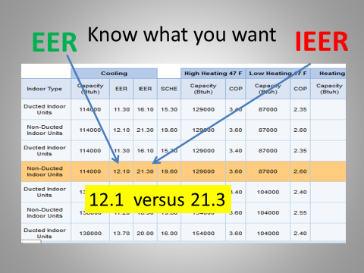
Problem with IEER – when is a 12 a 21?
Actual screen shot from AHRI directory
EER is the unit power consumption vs output at one point
IEER is adjusted
Not to your building – to a test
Confusing?
Misleading?
Yes, Benchmarking is the friend of Hydronic Systems because they
deliver at the utility bill.

Slide 12

Hydronic Advantages
With Water the system operates inside design parameters
The lowest cost way to transport energy
Hydronic systems maintain efficiency
You choose air delivery or radiant delivery
Water-cooled units are more efficient because of
high heat transfer capability
Terminal units receive controlled Design water temperatures
It is water – it can be variable flow and temperature

Slide 13
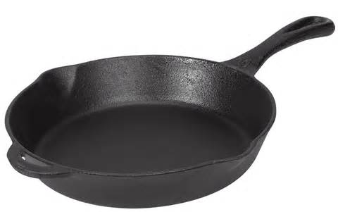
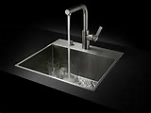


High Heat Transfer? Cooling a hot skillet - What is Faster?
Water
even
100 degree dishwater
Wave around in
70 degree air

Slide 14

Protect your investment in Efficiency
Water always Wins
Equipment and components exceed 20 years
Options and Choice fit the budget
Options and Choice meet Owner Requirements
Options and Choice ensure system life
Options and Choice ensure system integration for the whole building – Forward and Backward compatible
For the Life of YOUR BUILDING

Slide 15






Water: The Natural Choice
www.hia-c.org

