Slide 1

Better budgets with BEST™
Following slides
show how to use BEST™
for better budgets
Basic software program
Is
FREE to download
www.hia-c.org

Slide 2
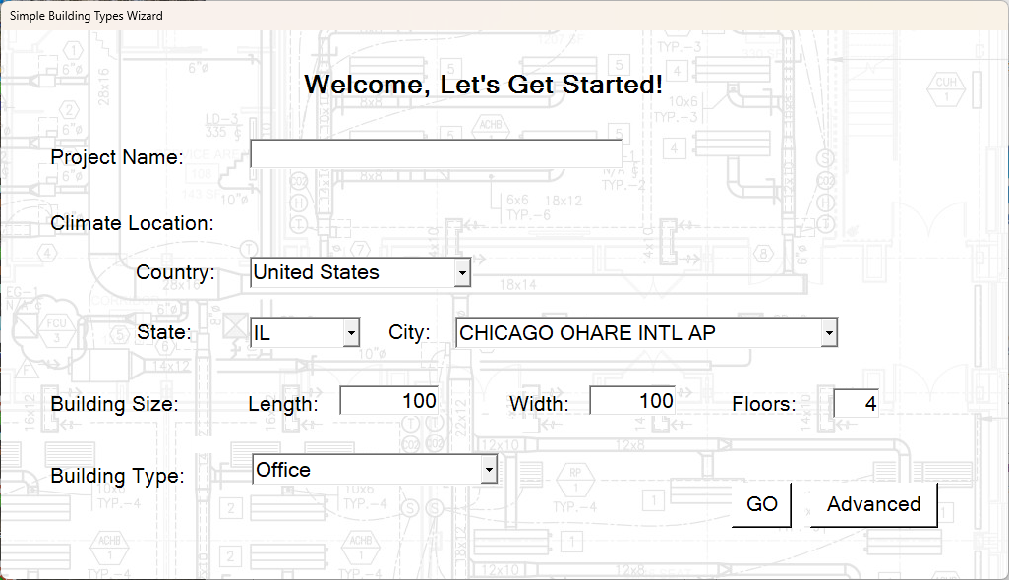
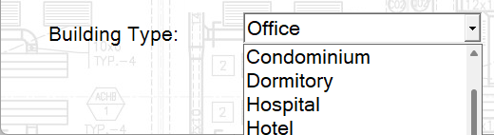
50 Contractor’s $/ft² average HVAC system estimates
46 United States, 3 Canada, 1 Mexico – all confidential pricing is averaged – not tied to location
Based on 30 pre-defined complete HVAC Systems
How to make it YOUR building…
Download BEST at www.hia-c.org
Select Climate Location
US, Canada, Mexico
Over 1000 sets of Bin Data
Enter Building Size
Select Building Type
10 in dropdown box

Slide 3
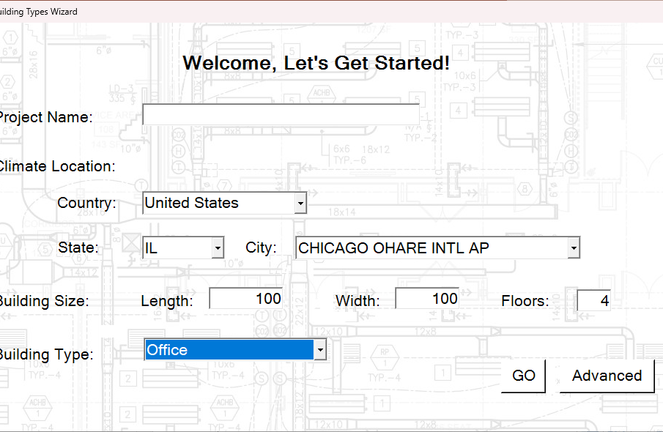
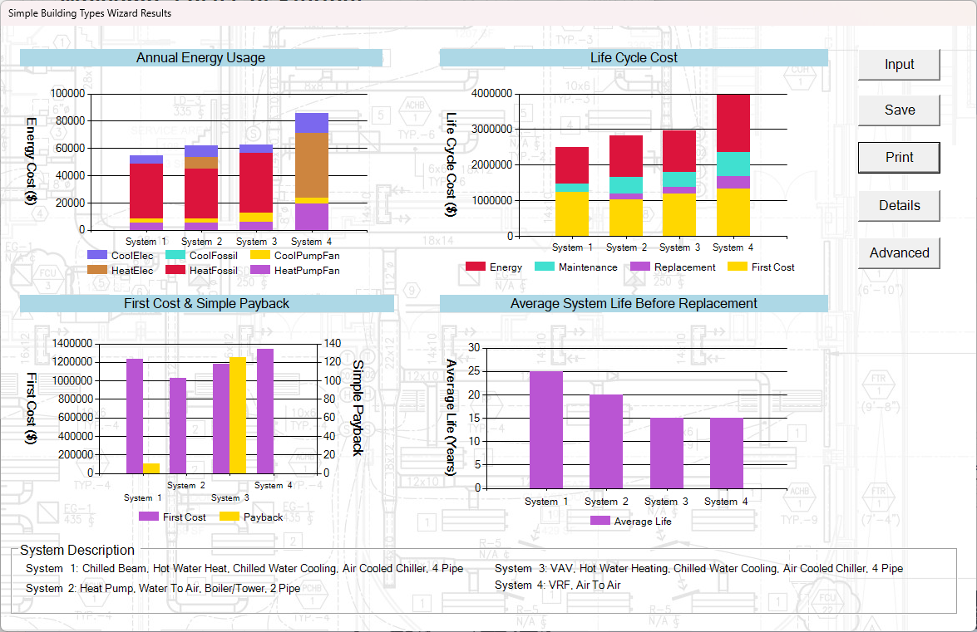

Click “GO” – to see what BEST can do…
Above – screen shot of opening wizard
Default sample is Chicago “Office”
“DETAILS”
Click details to see: 9 color charts and tables
  The project and each of 4 systems
  or variations on one system type if you choose
“What is effect of decarbonization on your costs?”

Slide 4
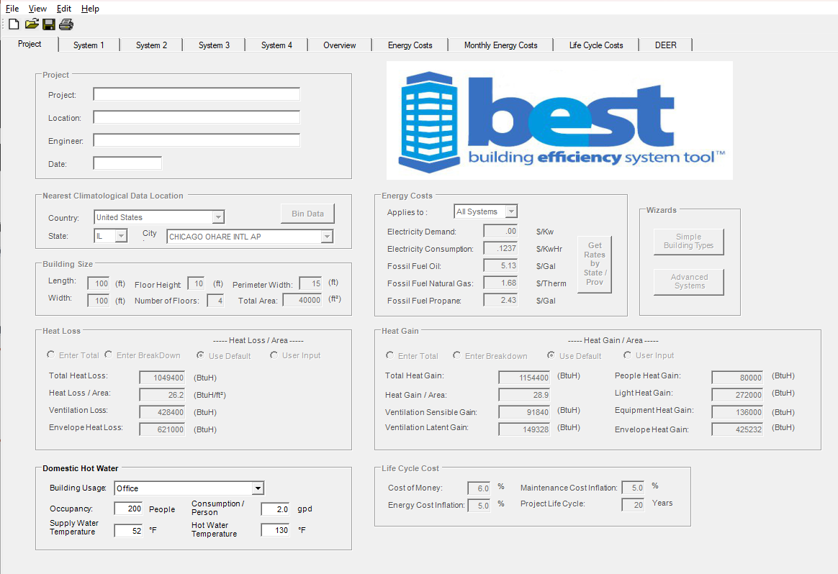
All assumptions ready for your Team to change
Comprehensive “Box Model” consumption and CO$T
Per system – annual, monthly, life cycle, and at demand
For your use only
Verify your input
Review: Utility cost
  Example is EIA average
Loads – sample is typical
  4 ways to reenter
Every input is changeable
But track your changes
Unless you save
When you close it goes away
We cannot “mine” your data
BEST is Confidential
HOW? Its downloaded…
Weather
Utilities
System
Wizards
Building
Heat Gain
Heat Loss
Water Heating
Life and
Maintenance

Slide 5
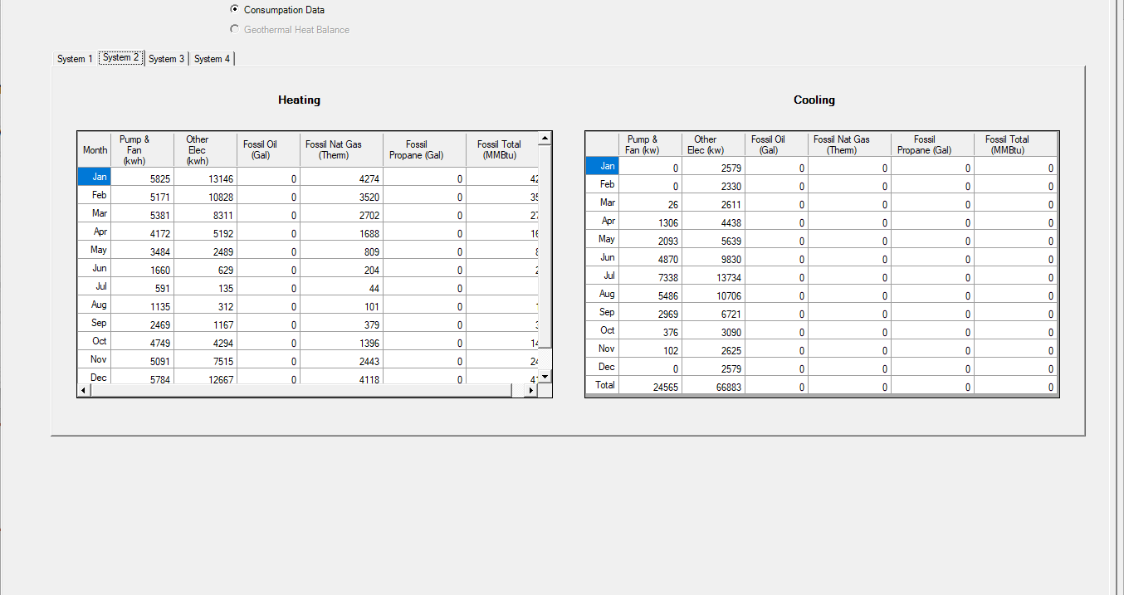
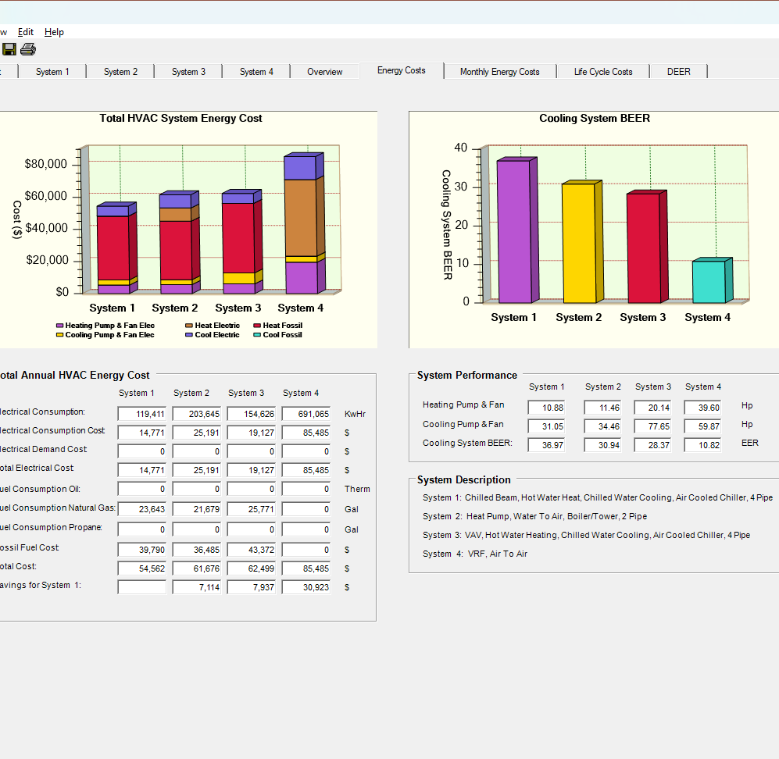
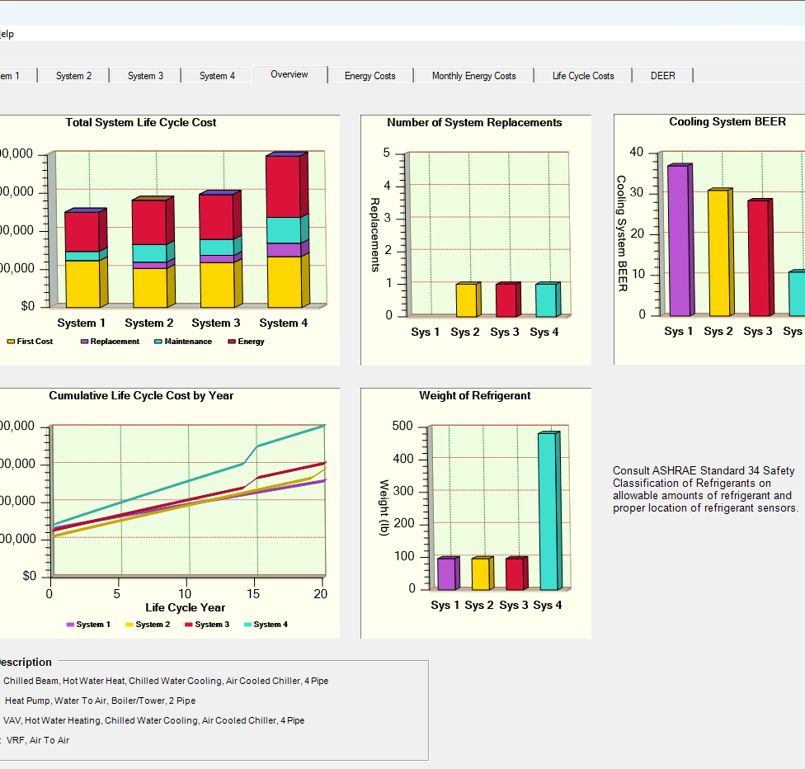
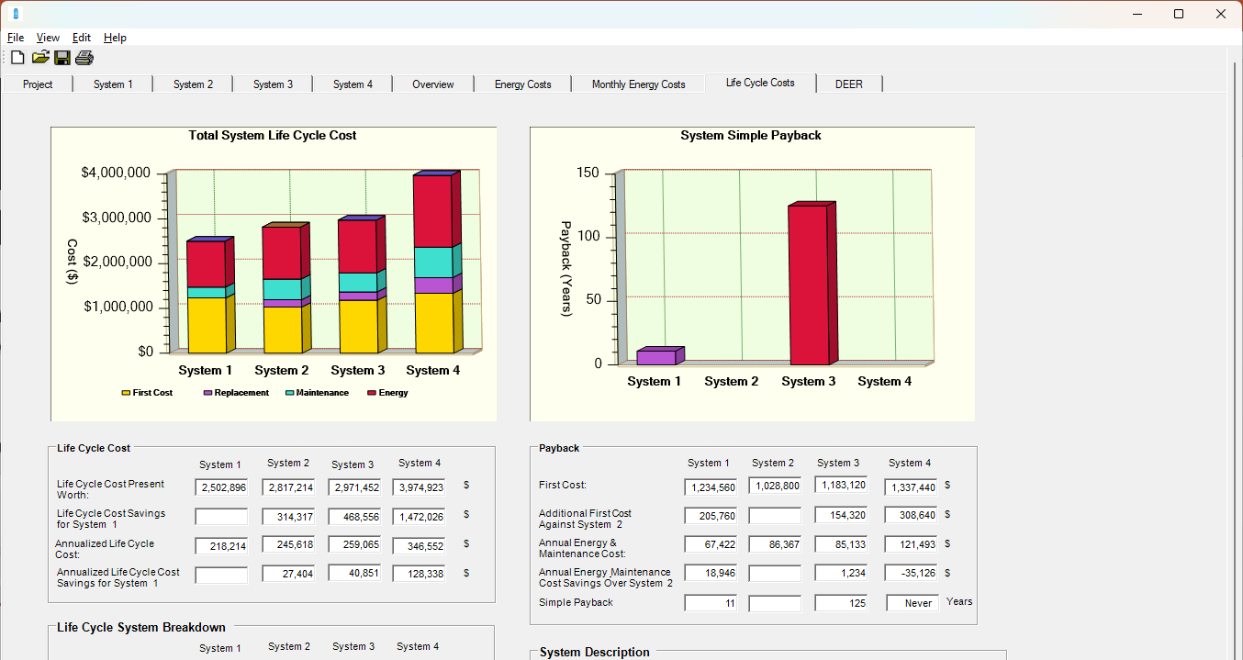
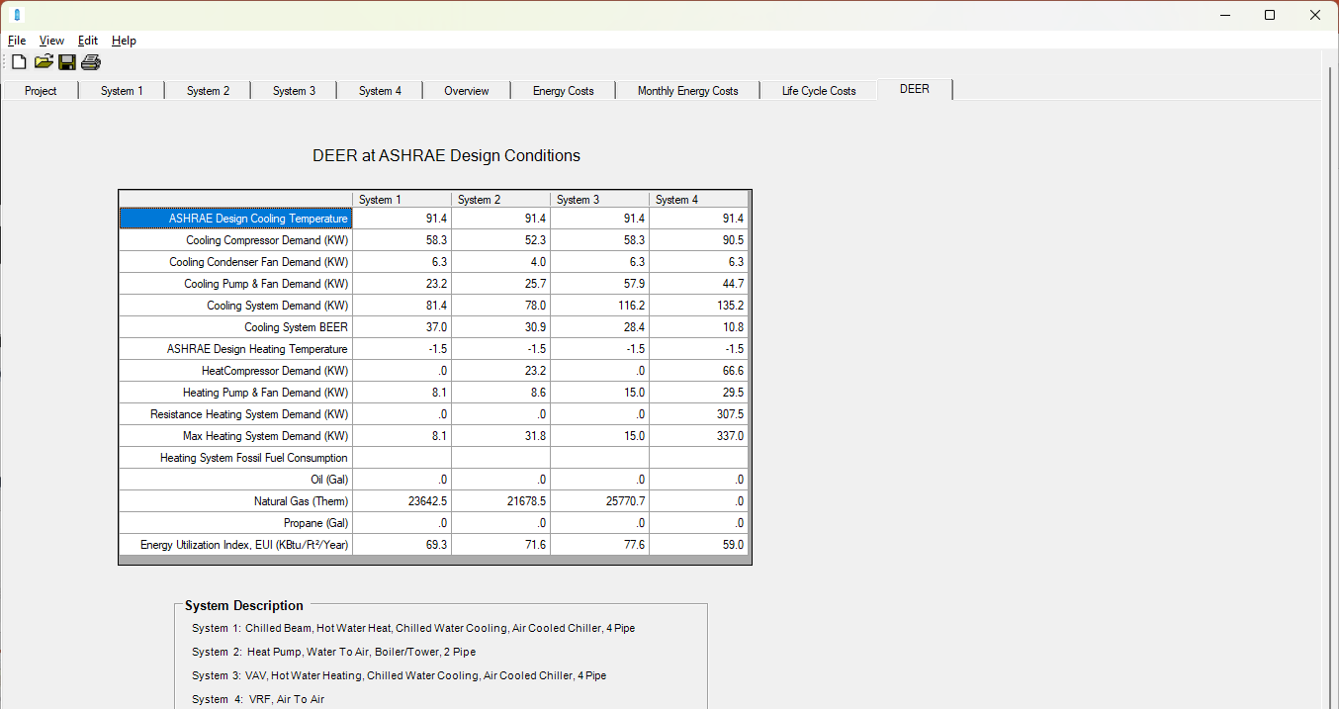
Comprehensive OUTPUT details effect and cost energy use and cost per major component and total
Every Design Engineer can model new or existing
BEST is for everyone - a tool to define cost & effect
Communication of and definition of Choice with effect on cost – all costs
per system per month
consumption and cost
Four systems at once in minutes
Same system different components
Annual consumption and cost, Monthly breakdown, power and fossil fuel
Demand
Day
Energy
Defining how building will be heated and cooled = better budget
Best™ is a complex template – Samples are “typical” - an informed start

Slide 6
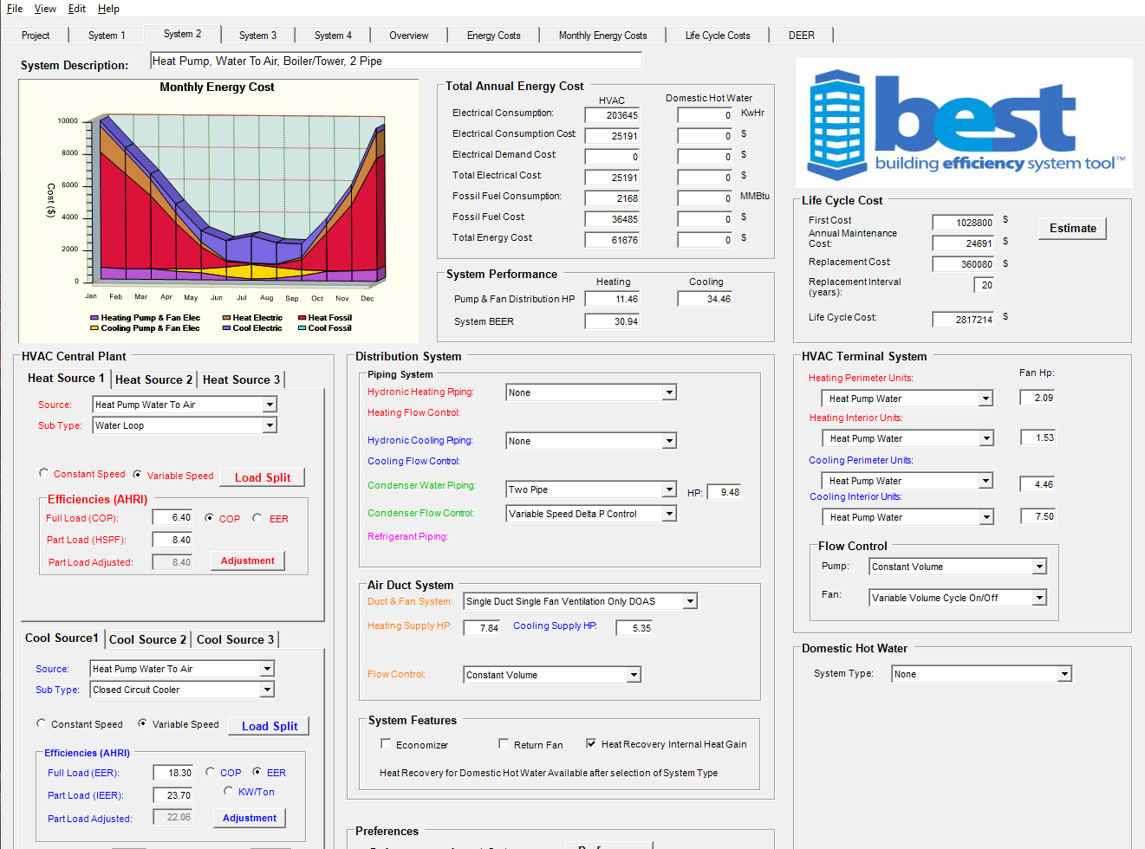
The System Screen defines parameters for better budgets
Design Team Input
  Examples are based on current industry practice
  Clarify and verify system, component efficiency, THEN cost
Heating – primary and backup
Cooling – single or multiple sources
Efficiency
  Examples are AHRI high average
Distribution of comfort
key - it is up to 50% of energy
Terminal – what will control space
Ventilation air – How?
Water heating
Major Components defined
Ready for BUDGET – click “Estimate”

Slide 7
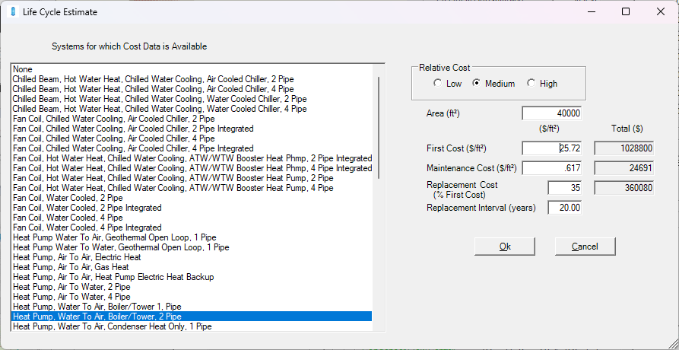
System Examples Described average $
Radio button or
Individual Cost entry Wizard
“ESTIMATE BUTTON”
Your System at newly defined Costs: Components changed? “what’s it cost?”
  First Cost ($/ft²)
  Maintenance Cost
  Replacement Cost
  Replacement Interval
Click “Ok”
SAVE or gone…
The team is on the same page(s)
See effects of choice in minutes
Complete HVAC&W system
kW and HP = $
Decarb + Water Heating
Hybrid or Cascade
Water versus air and at ASHRAE demand
www.hia-c.org

Slide 8
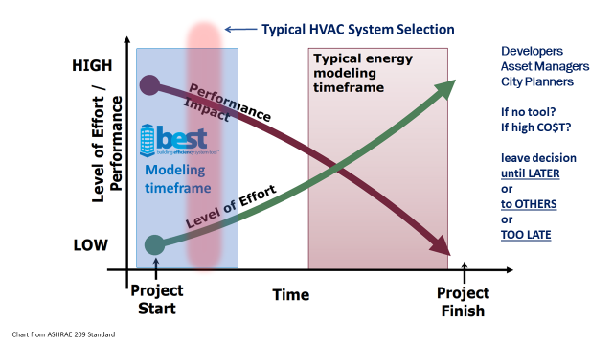
Thank you
www.hia-c.org

